Slide 1
Bronze Sculpture
The Process, from concept to installation
By RS New

Slide 2
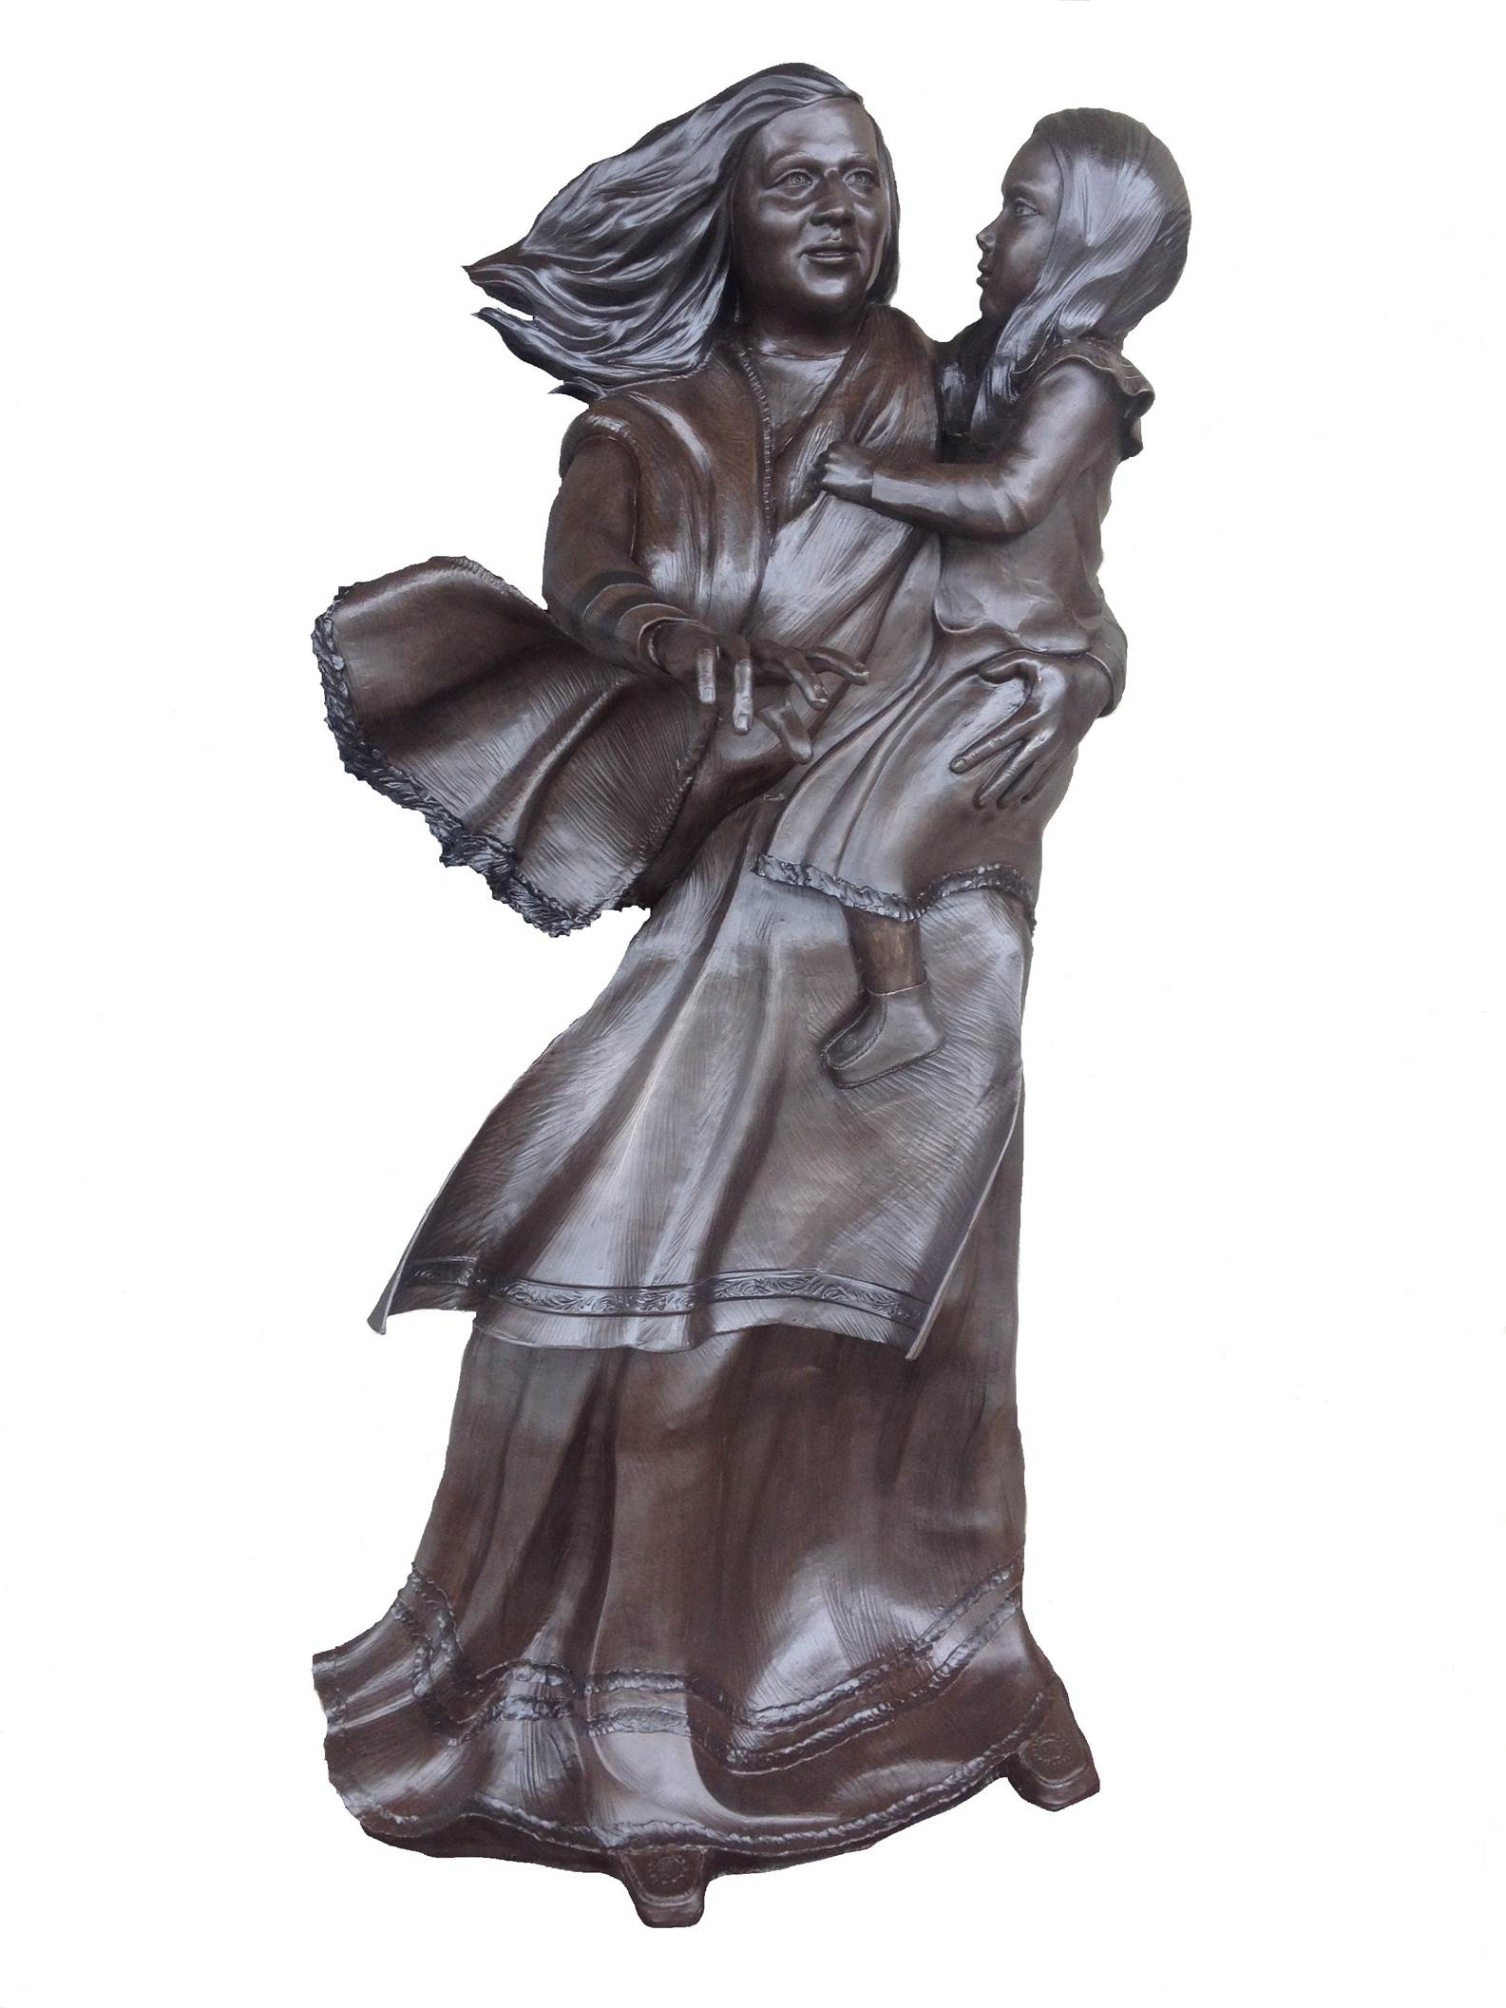
With this presentation, I would like to take you through all of the steps required to create a bronze public sculpture or statue. This statue is entitled, “Sehoy, Matriarch of the Wind Clan”, and it was commissioned by the Poarch Creek Indians in Atmore, Alabama. I’ll use this statue as an example of how an artwork develops starting with its first conception. All projects start with simple conversations between the artist and the client. Eventually, a story develops. I call this phase “The Narrative”……

Slide 3
The Narrative
Every good bronze public sculpture tells a story. If the statue is a famous person, it gives us a glimpse into an aspect of their life. Consider the story of Sehoy. She was born in 1700. She is the matriarch of the Wind Clan. There is an ancient story in her culture where a dense fog covered the land, making it impossible for the Muscogee to find each other. Then, the master of Breath blew the fog away, and they found each other and became the Wind Clan. The Wind Clan people are “matriarchal.” That means their legacy is passed along from mother to daughter. So, I decided that the bronze portrait of Sehoy Marchand should portray her telling the story to her daughter of how the Wind Clan came to be. I wanted them to be wearing colonial style dress, and make their hair and clothing blow in the wind. So I made some sketches…………

Slide 4
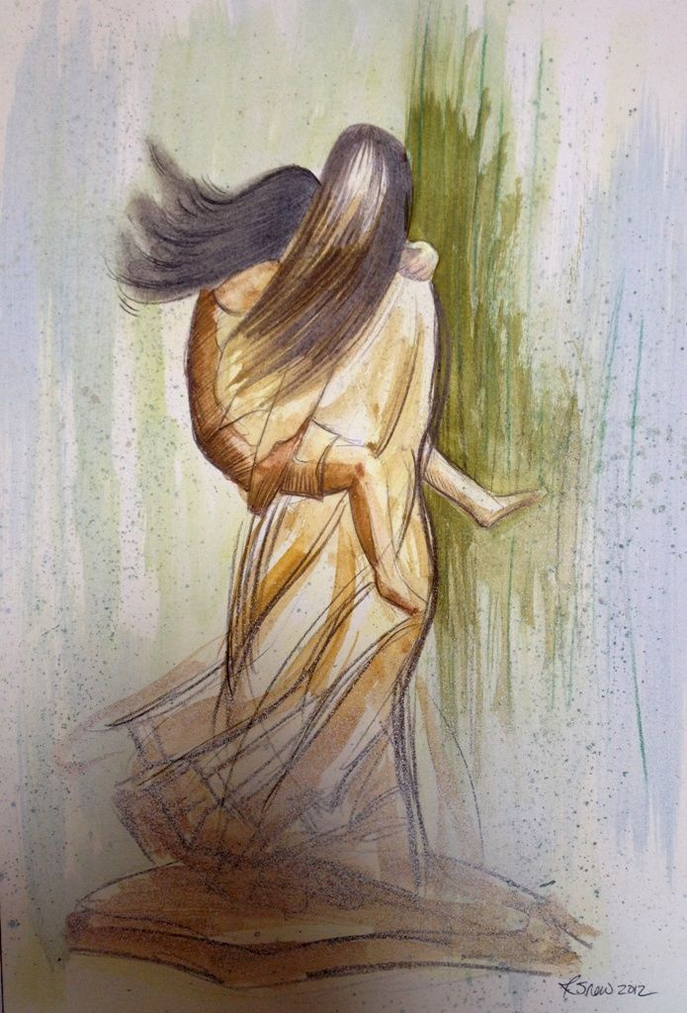
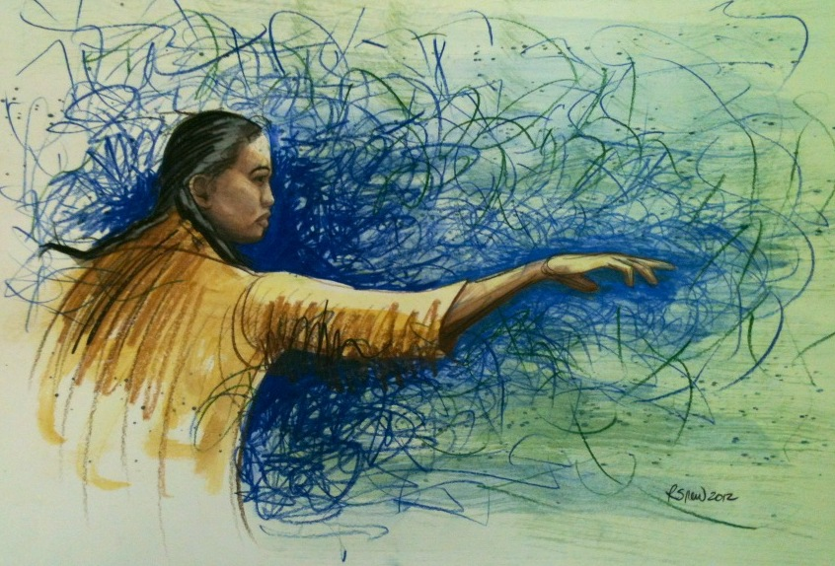
Sketches of Sehoy Marchand

Slide 5
Reference Material
After the sketches and the concept are approved by the client, it’s time to find models and dress them and pose them like actors playing a role. I found models for Sehoy and her daughter that actually descend from the Poarch Creek Indians. So, I took lots of pictures………..

Slide 6
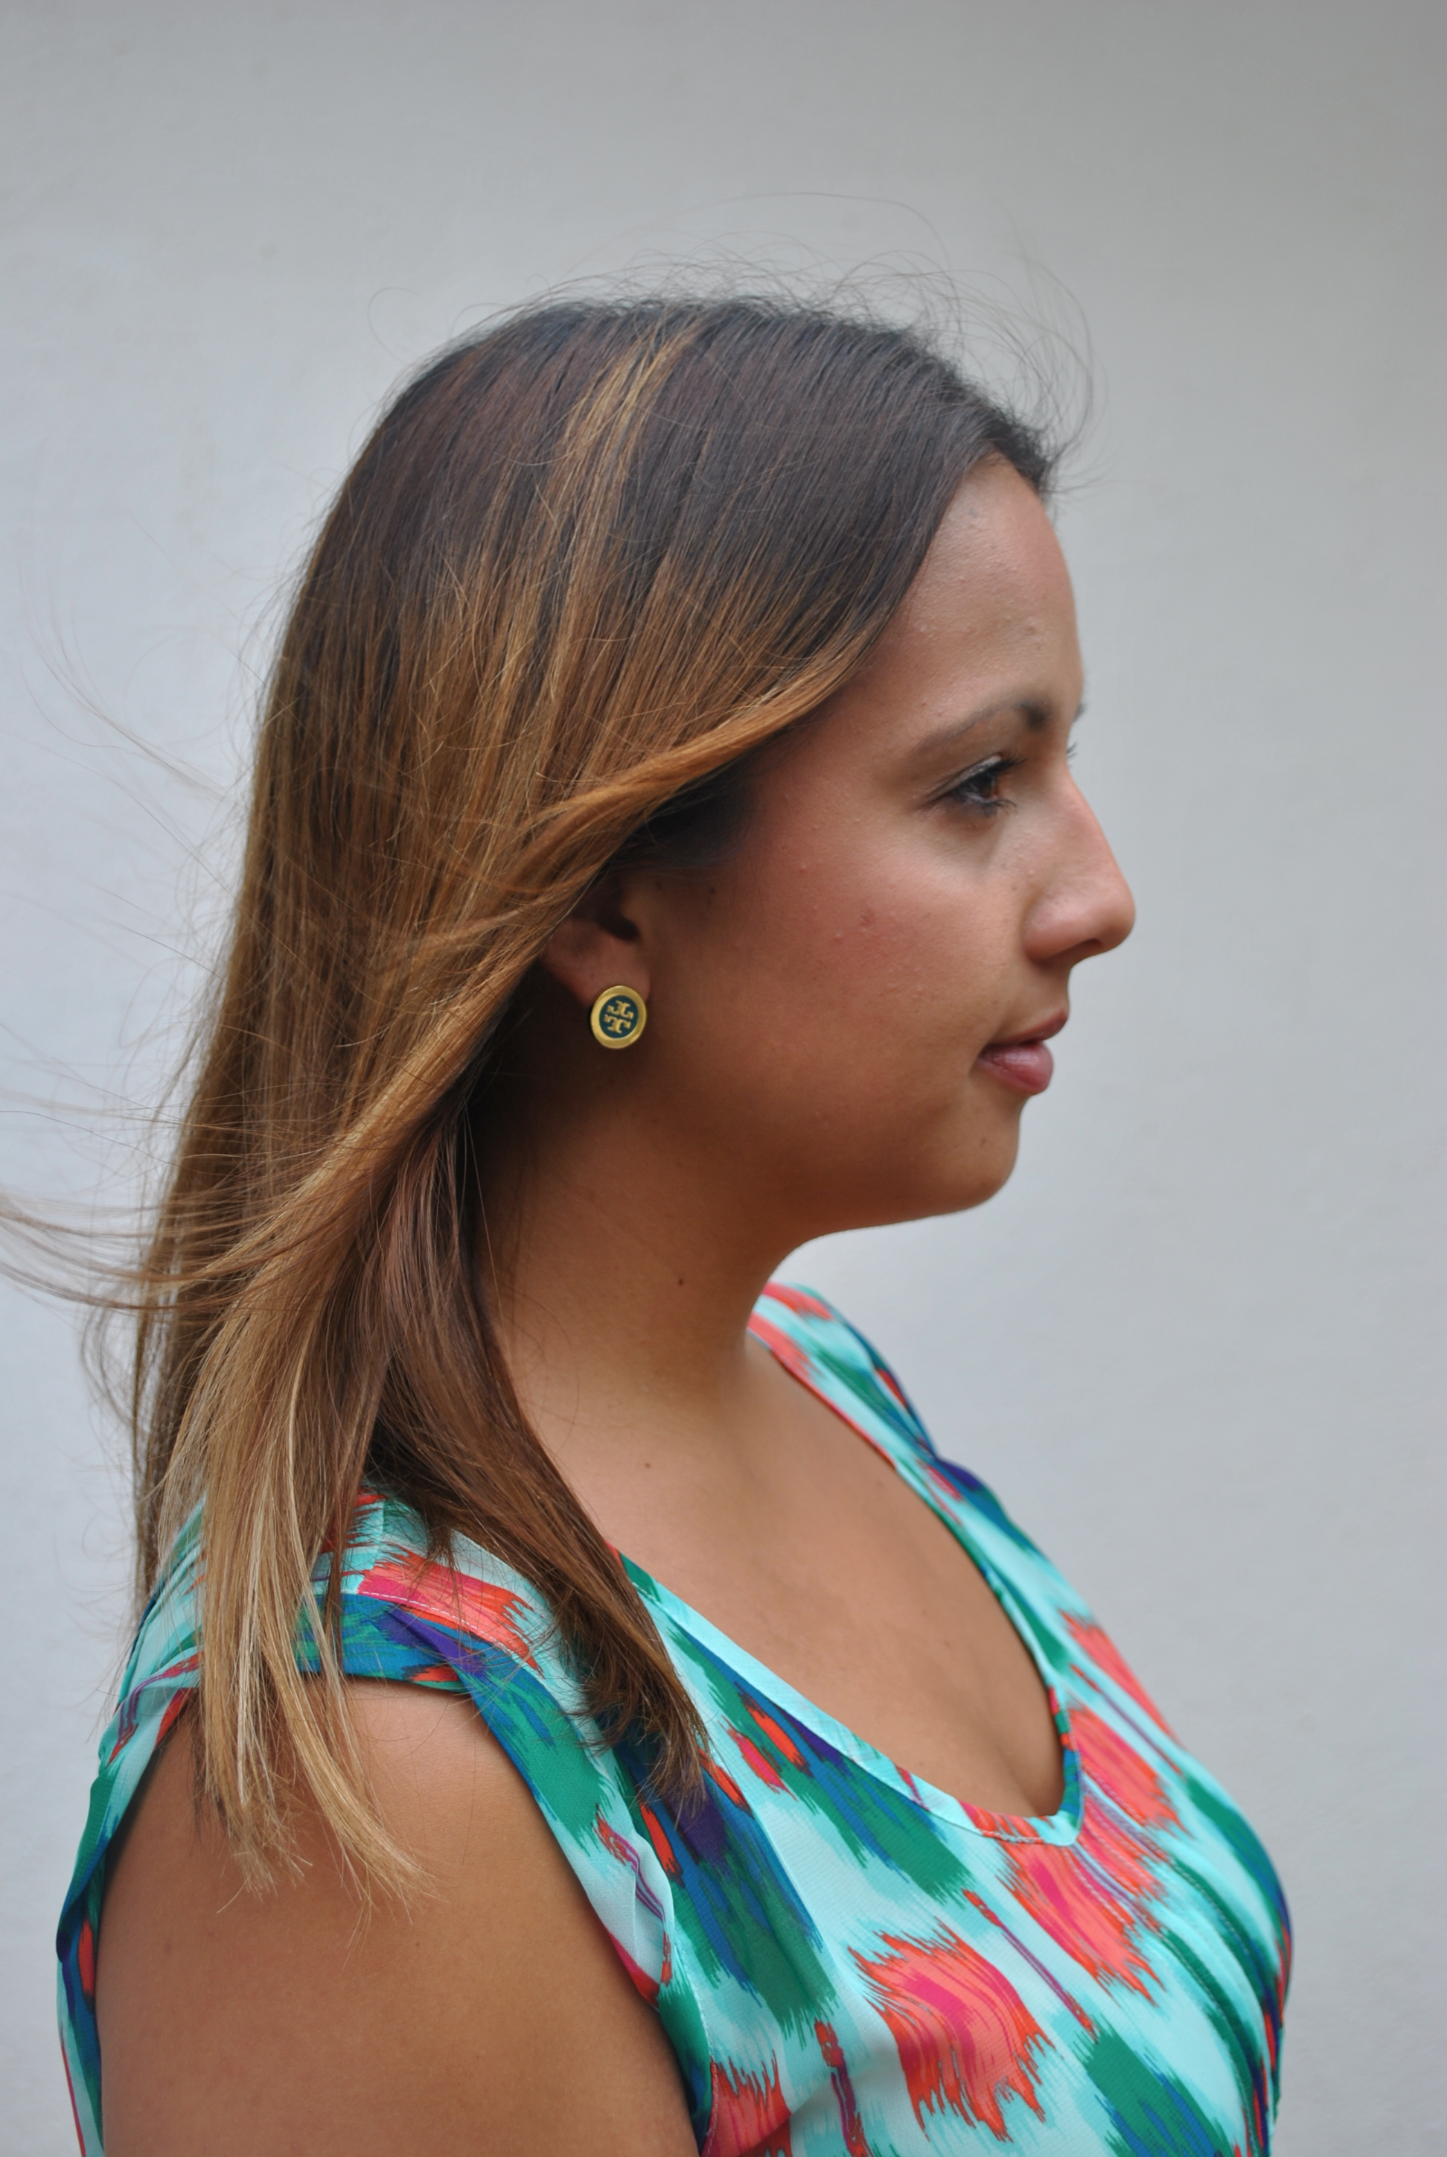
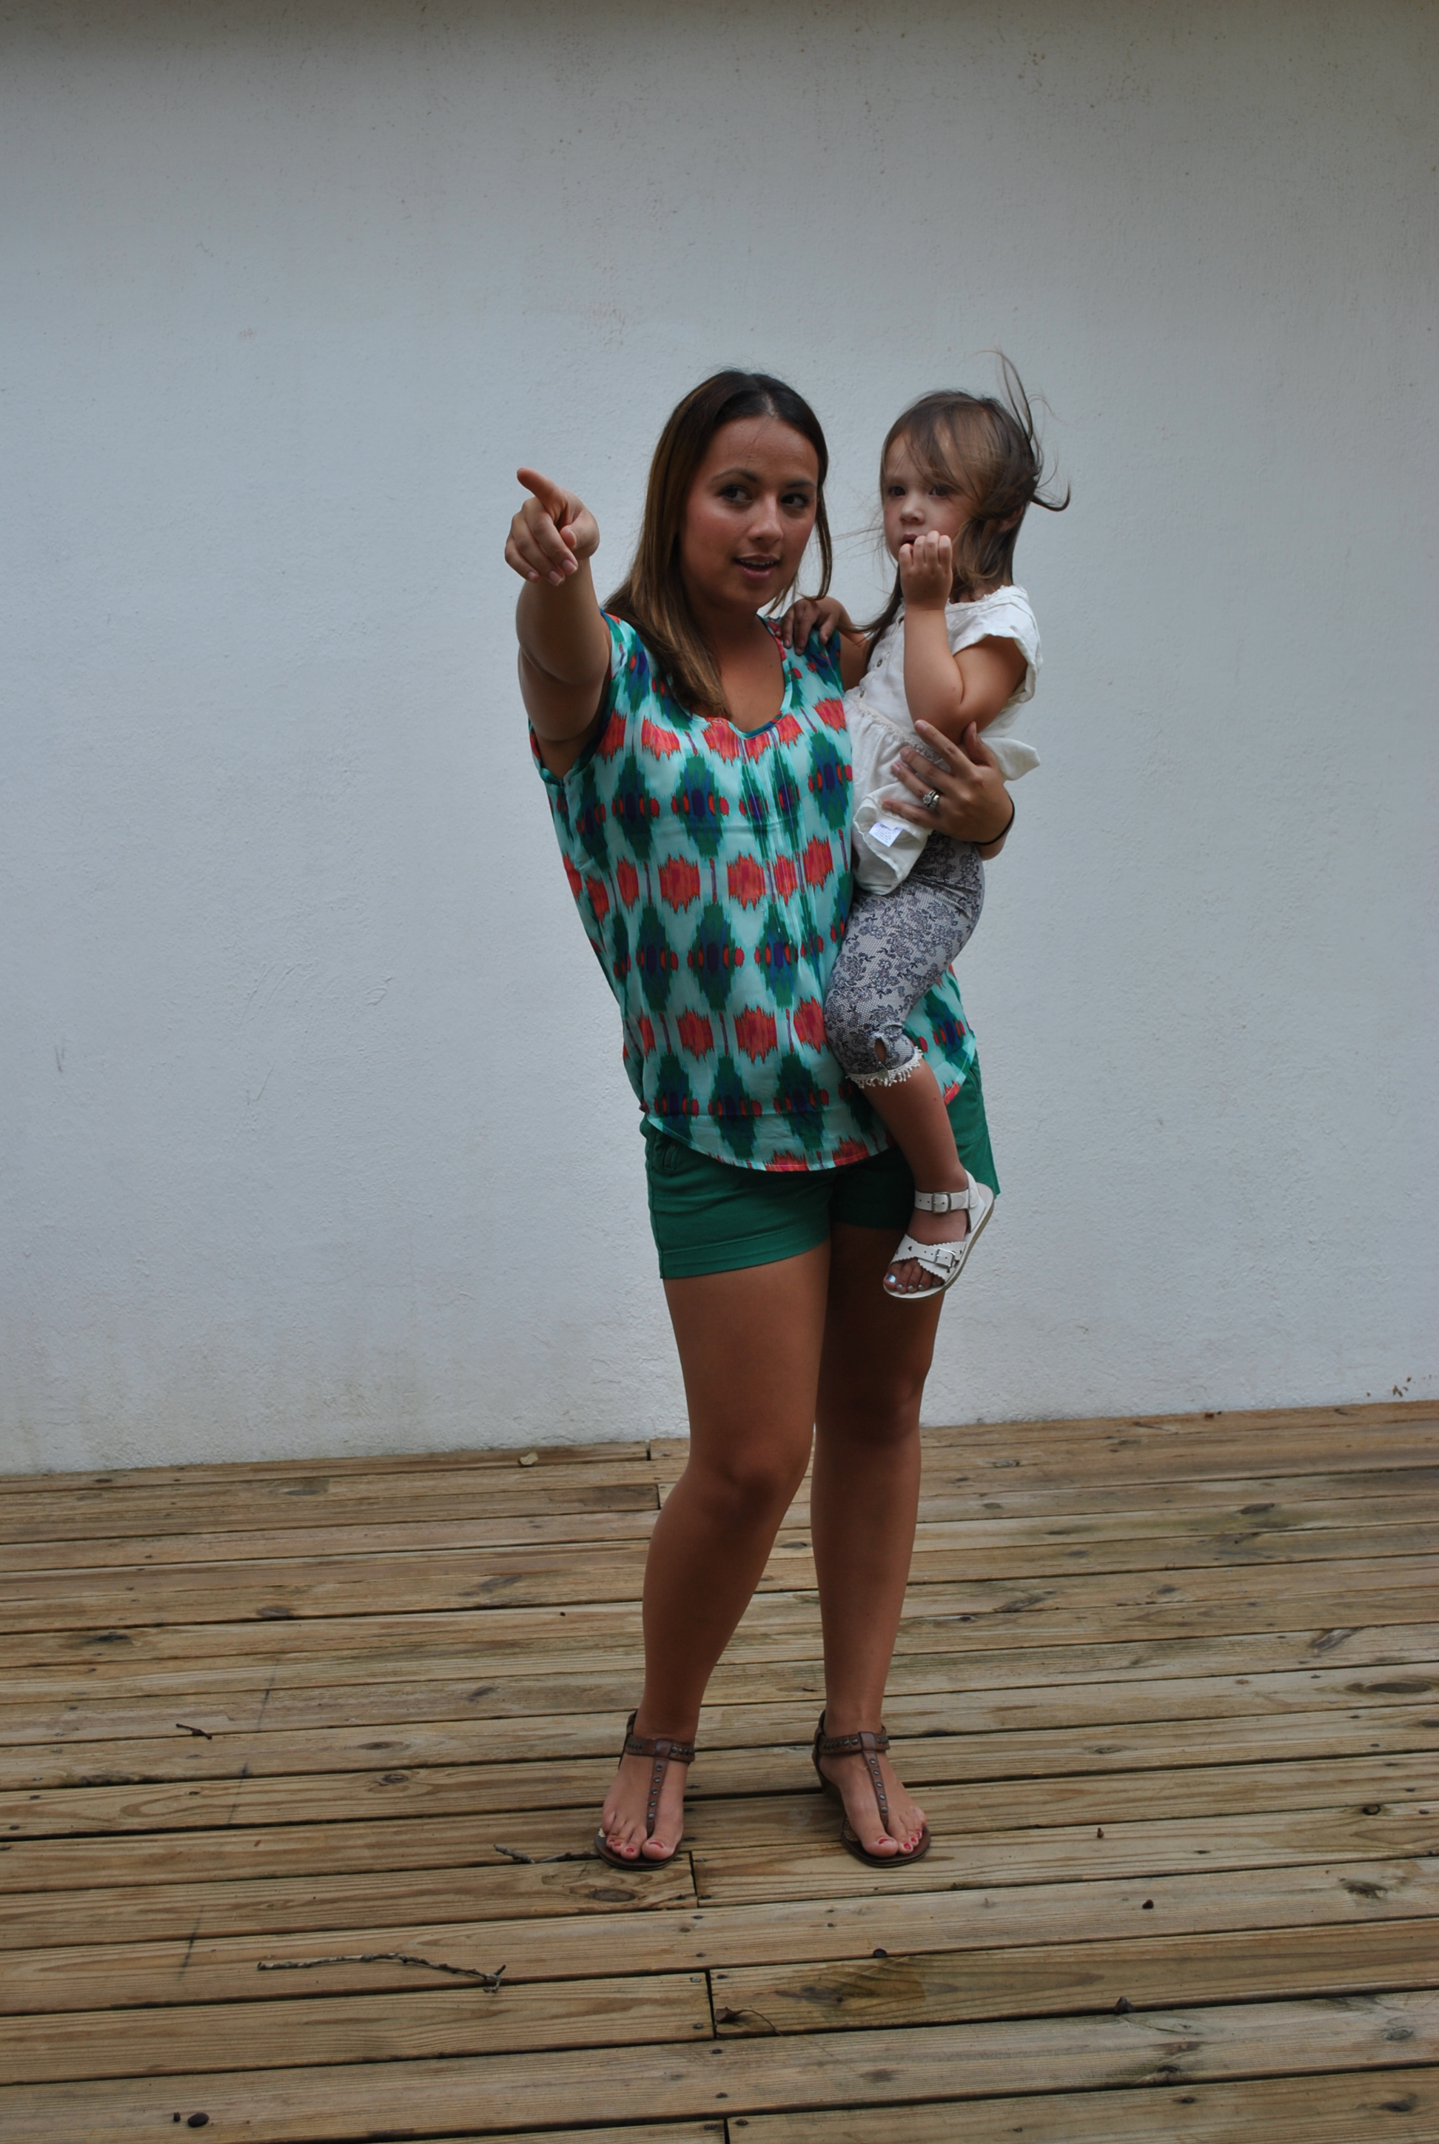
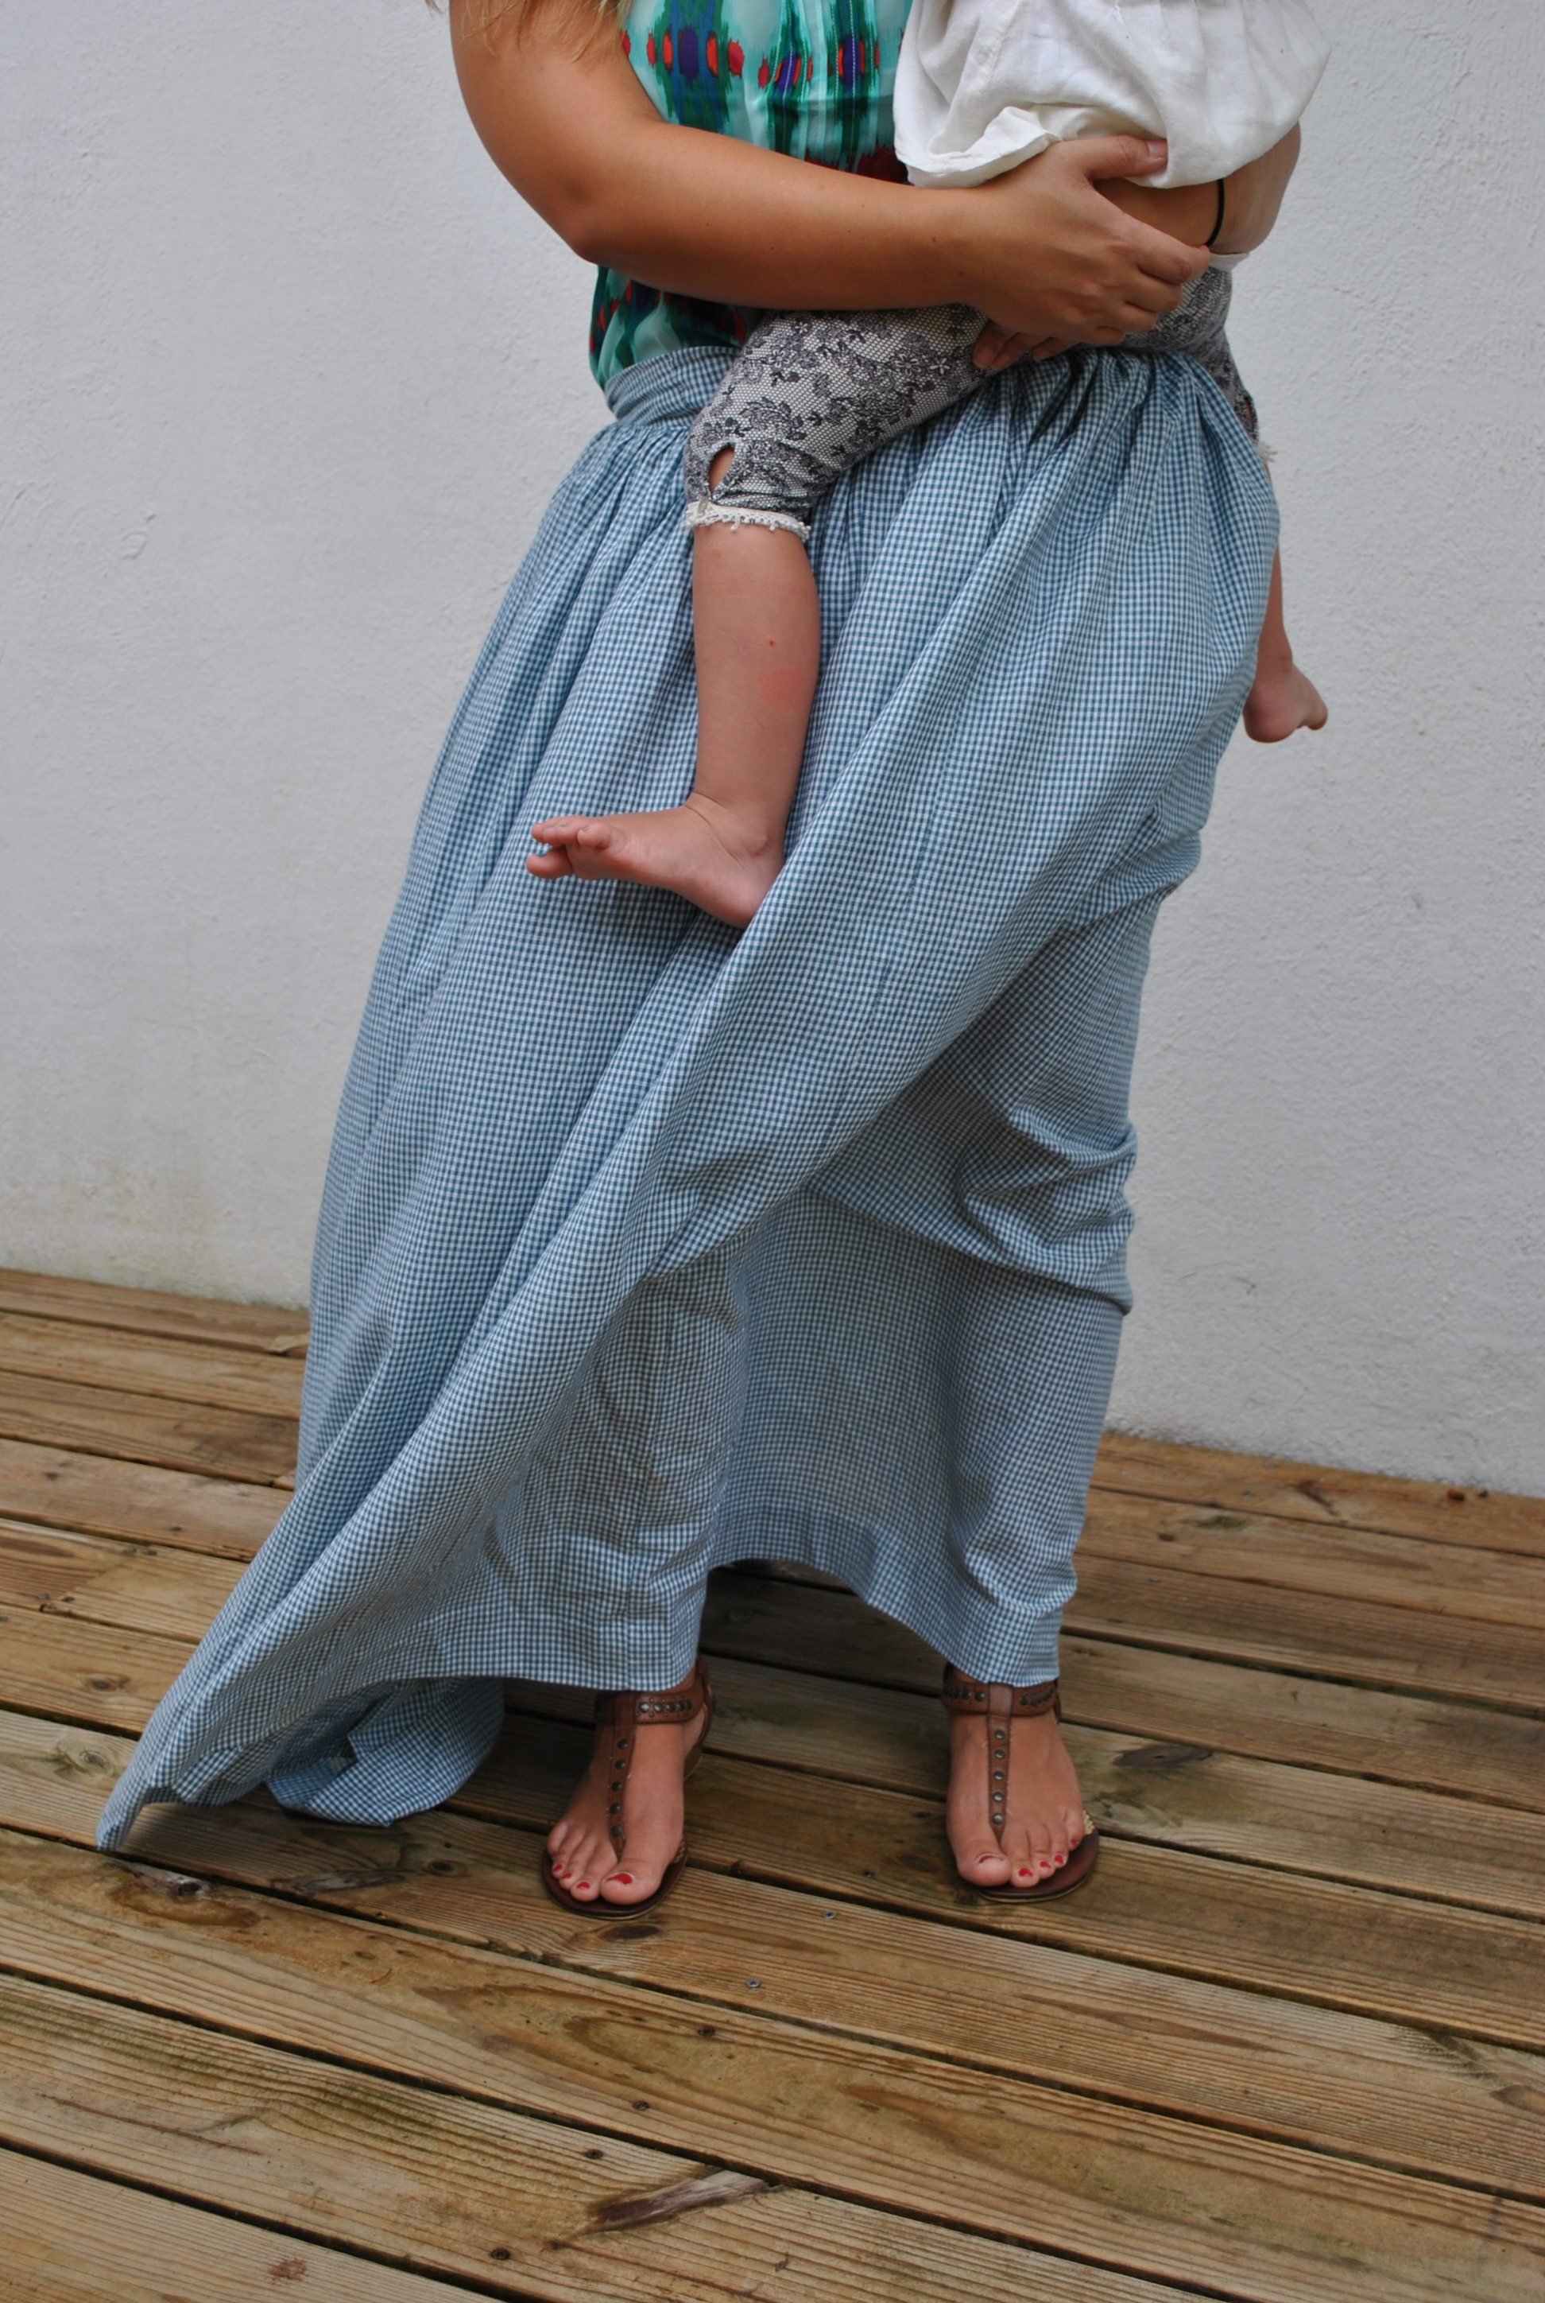
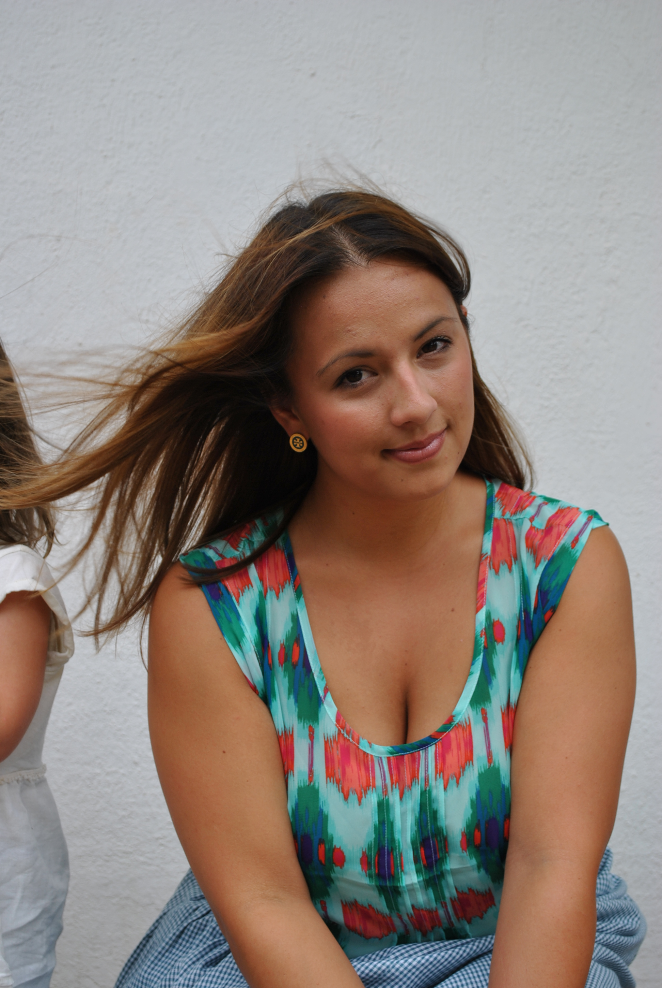

Slide 7
The Maquette
The “maquette” is a small scale 3D sketch of the proposed large scale finished bronze sculpture. It is generally made of clay and usually not very detailed. I like to finish my maquettes with as much detail as possible so that the client can see exactly what they are getting; and, I like to have my miniatures cast in bronze so that I have a remembrance of the finished statue. I constantly refer to my reference photos as well as measurements that I took during the modelling session. I decide upon a scale which is the proportional relationship of the miniature to the final piece. It is usually 25% or 1 to 4 which means that an 18 inch model is ¼ the height of a 6 foot final figure.
The maquette begins with an armature which is usually wire and wood……

Slide 8
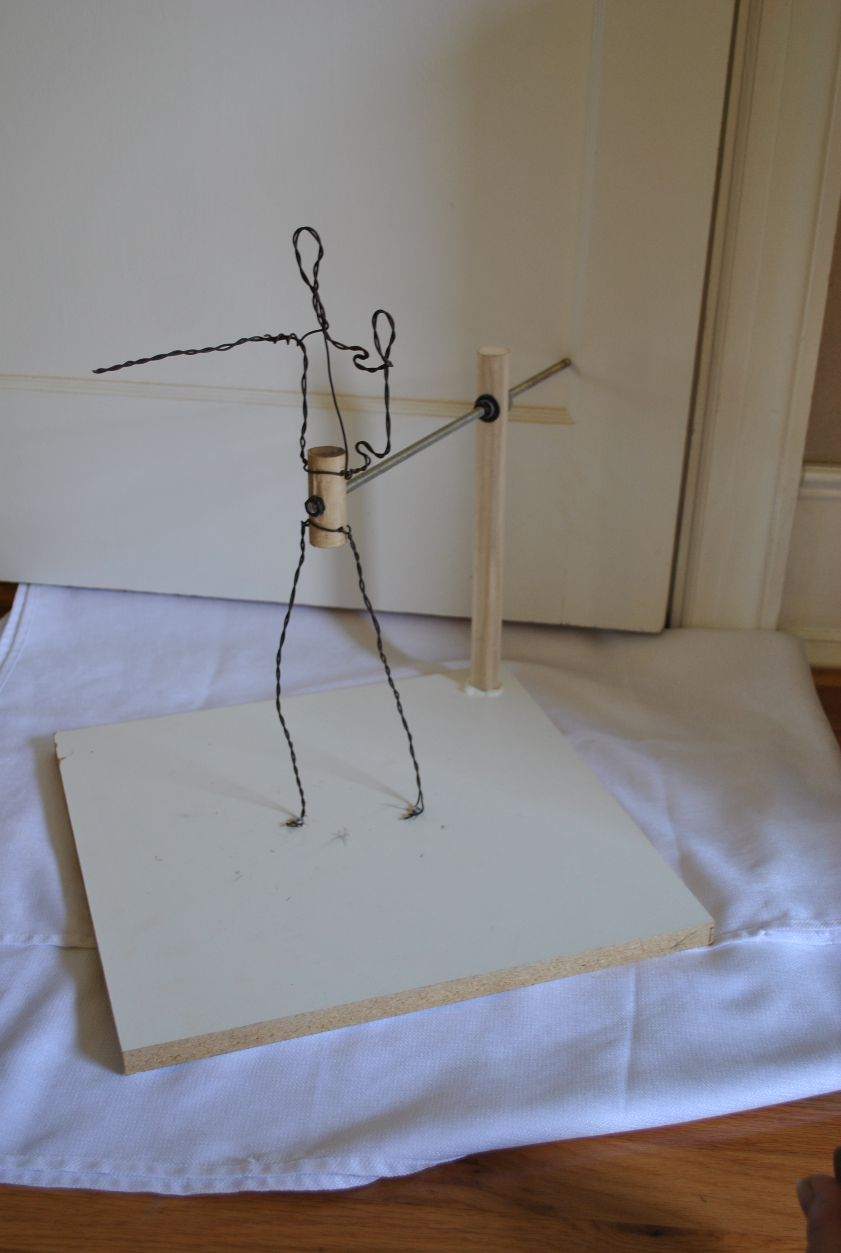
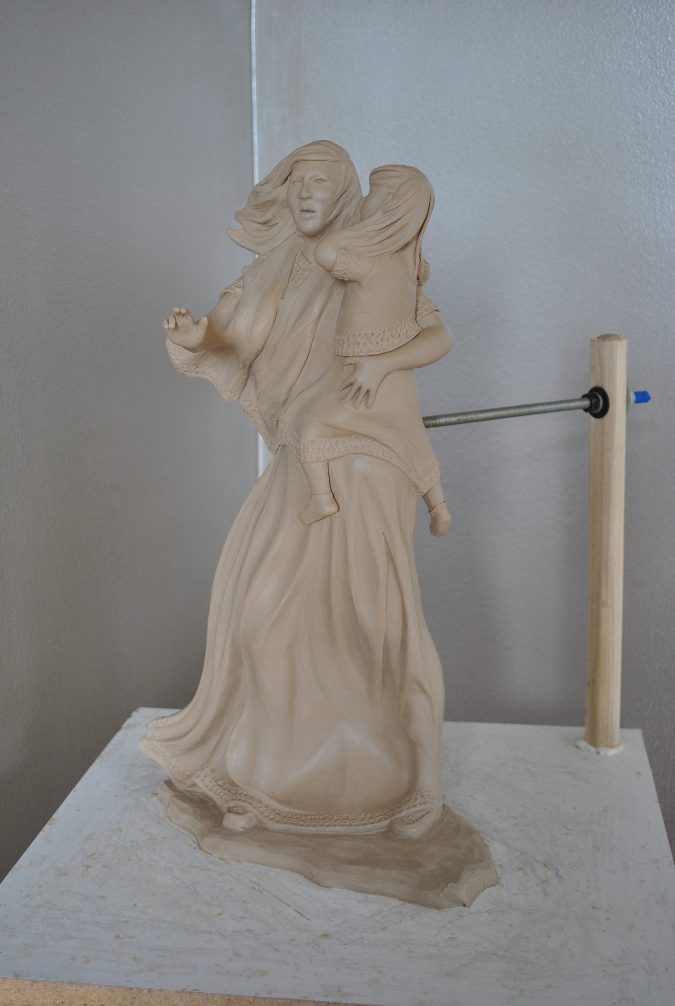
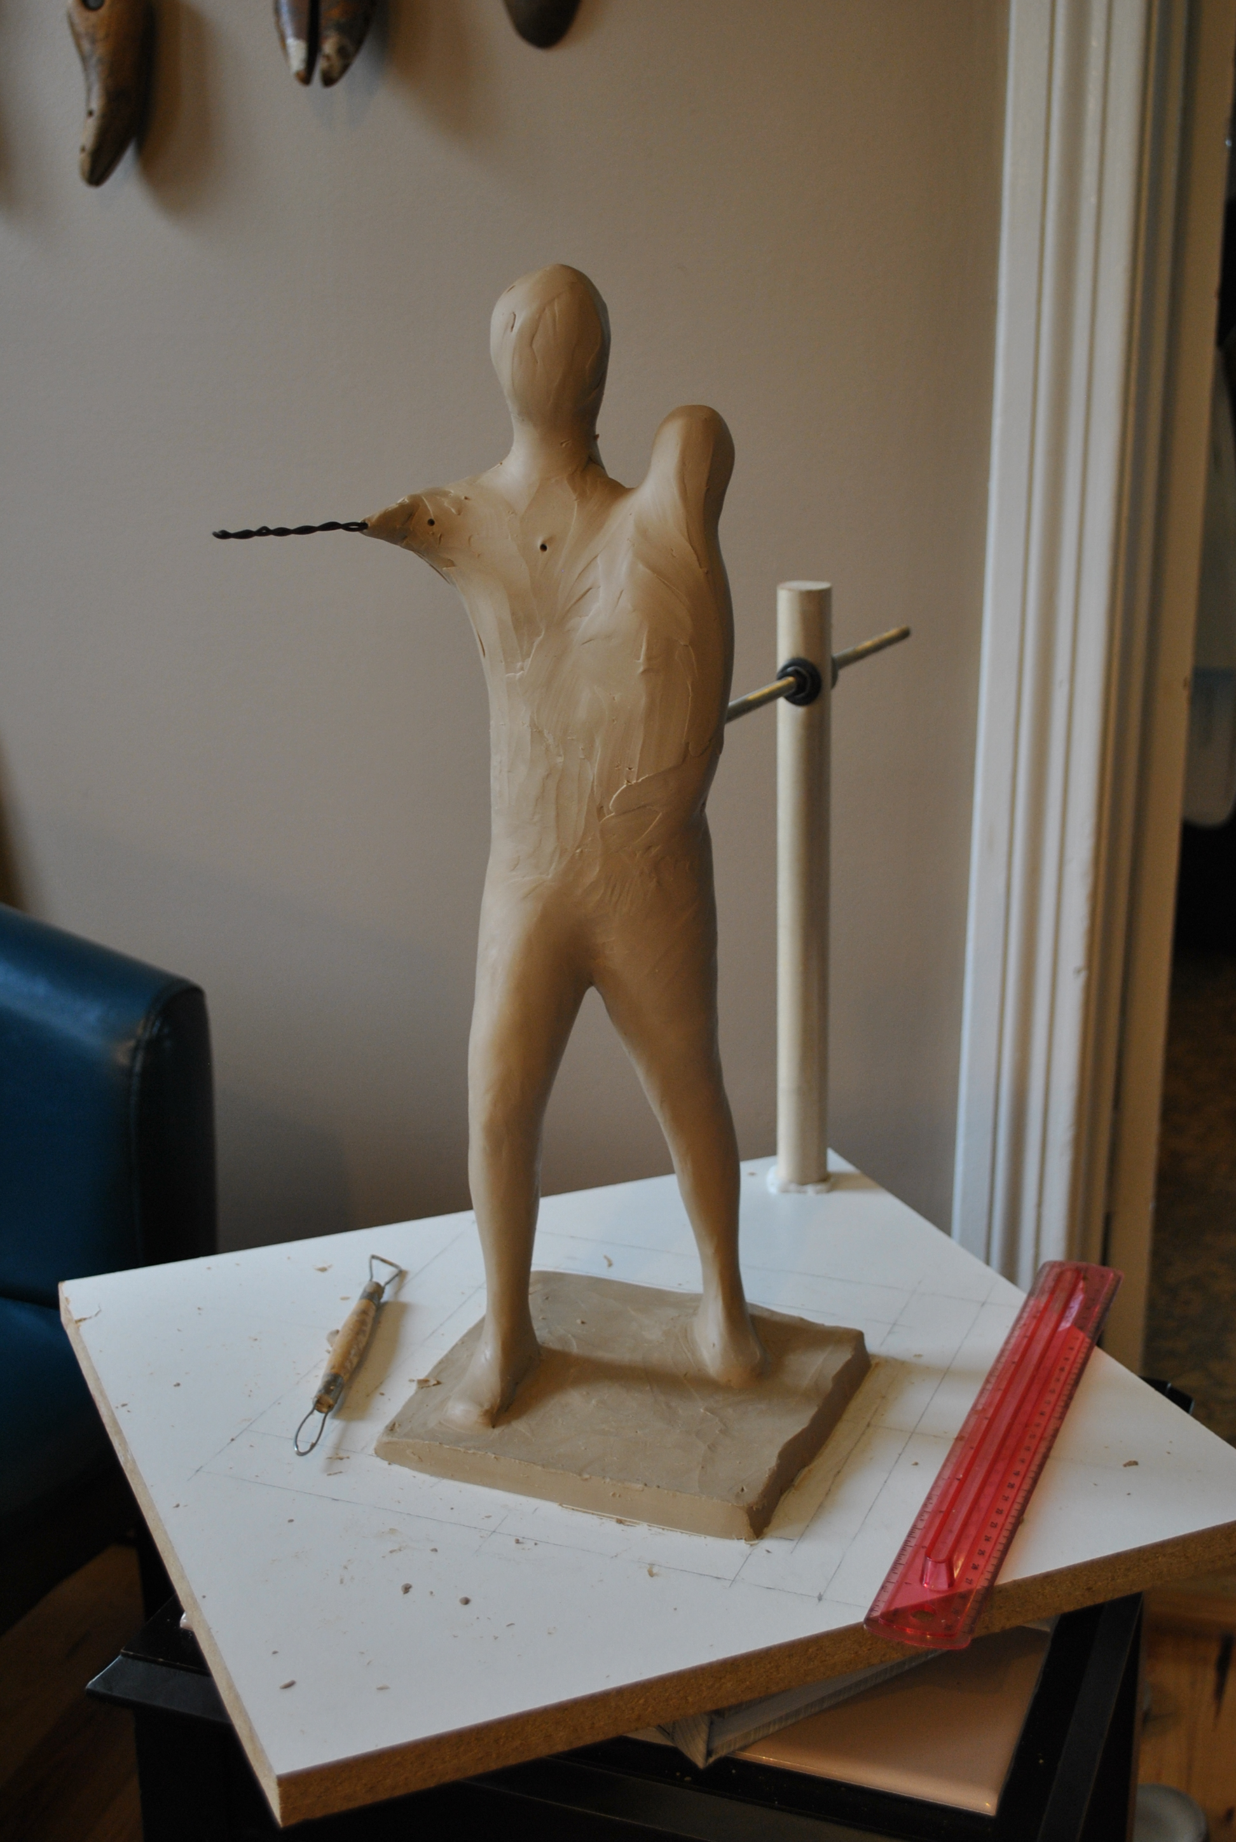
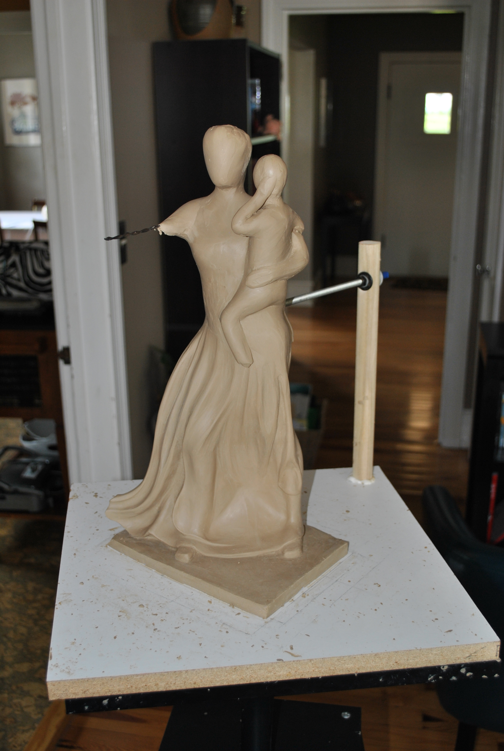

Slide 9
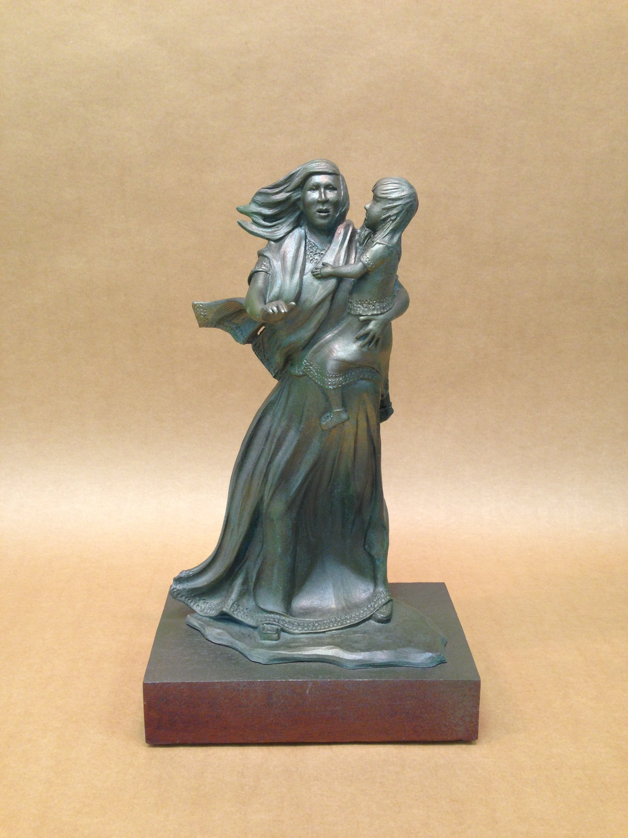
This is the finished bronze scale model of “Sehoy, Matriarch of the Wind Clan”.
18 inches tall

Slide 10
enlargement
Enlarging the scale model can be accomplished manually using a method called “pointing,” or, these days, digitally using a CNC machine. With the manual method, an armature is created from (usually) metal just like with the miniature. Then all sorts of materials may be used to build up the final piece: wood, chicken wire, plaster, Styrofoam, and clay. It is painstaking and it may take months to complete. It also makes the model heavy and cumbersome; and, therefore, difficult to transport to the foundry. With the digital method, the maquette is scanned and sent to a CNC machine that “carves” it out of high density foam. It can be accomplished in days, and even shipped to the artist in pieces that can be reassembled. Since it is made entirely of foam, it is light, easy to manage, and elements can be changed or corrected with ease. Once the foam is sculpted close to the artist’s preference, it is then covered with clay and the entire surface is sculpted for details.

Slide 11
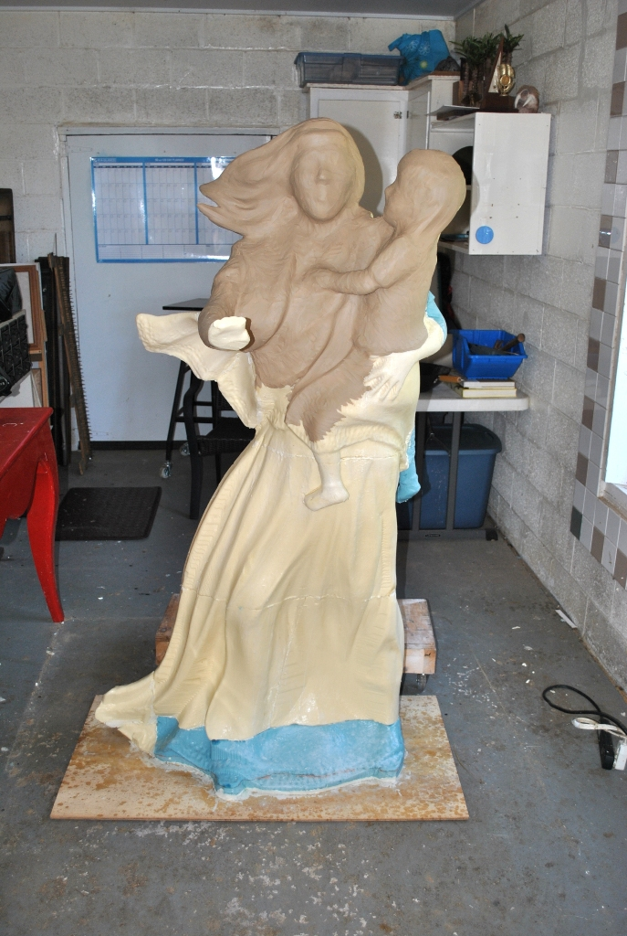
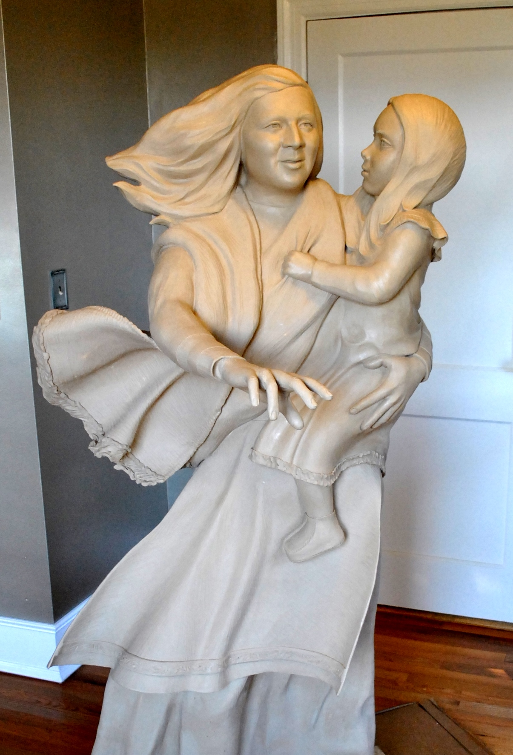

Slide 12
Delivery to the foundry
For most artists, this is the end of their contribution to the final piece. After delivering their work to the foundry, they may visit a few times to inspect the piece for accuracy at different stages during the process. I am fortunate to have a very good working relationship with my foundry, and the foundry is also close in proximity to where I live. I am involved as much as possible in every phase of the development of the finished product. It gives me a greater sense of ownership to the finished product, and it also assists the foundry by giving them some much needed help. Also, knowing about the process informs me for future sculptures. I have learned how to create artworks in such a way as to help the foundry with their production. We have become a team. Whenever I sign my artwork, I always include the foundry’s mark in order to give them proper credit.

Slide 13
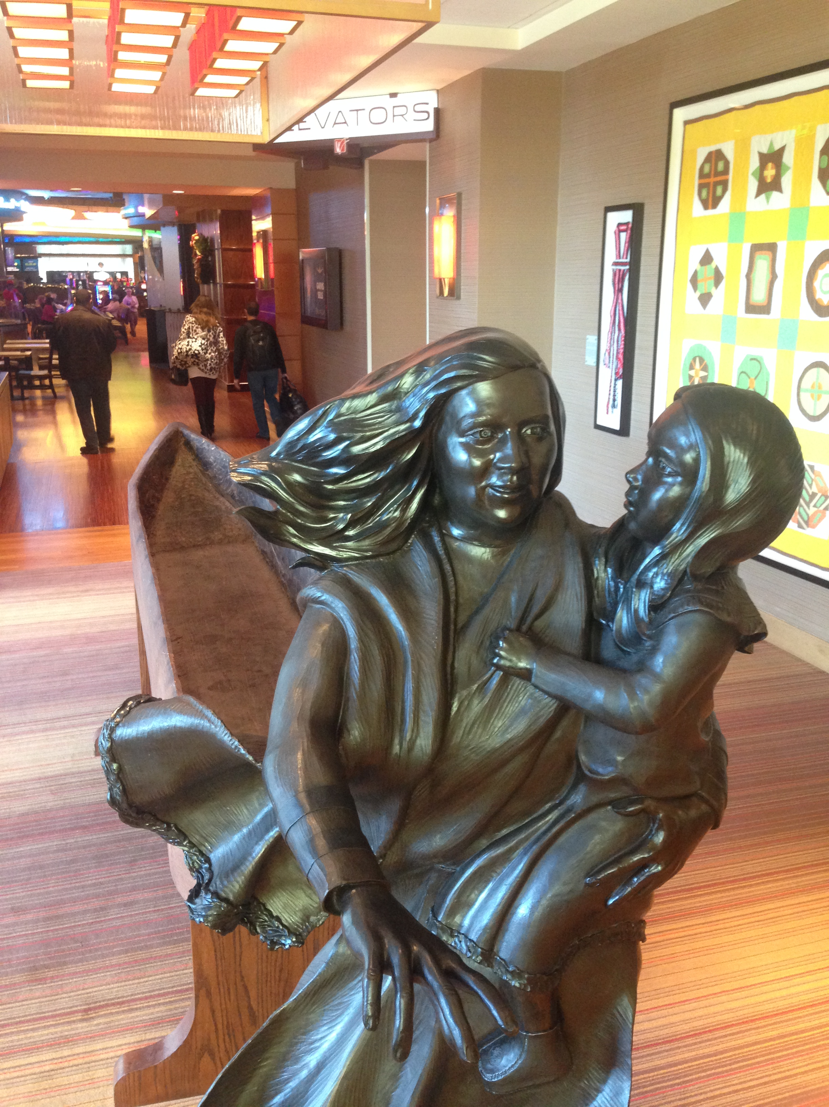
This is the finished bronze statue of Sehoy in place at a hotel lobby in Atmore, Alabama. The remaining slides that illustrate the different phases of the foundry work may portray other sculptures that I have created. The first step at the foundry is to create a mold first with silicone which is like rubber, and then an outer mold is created called a mothermold using either fiberglass or plaster……….

Slide 14
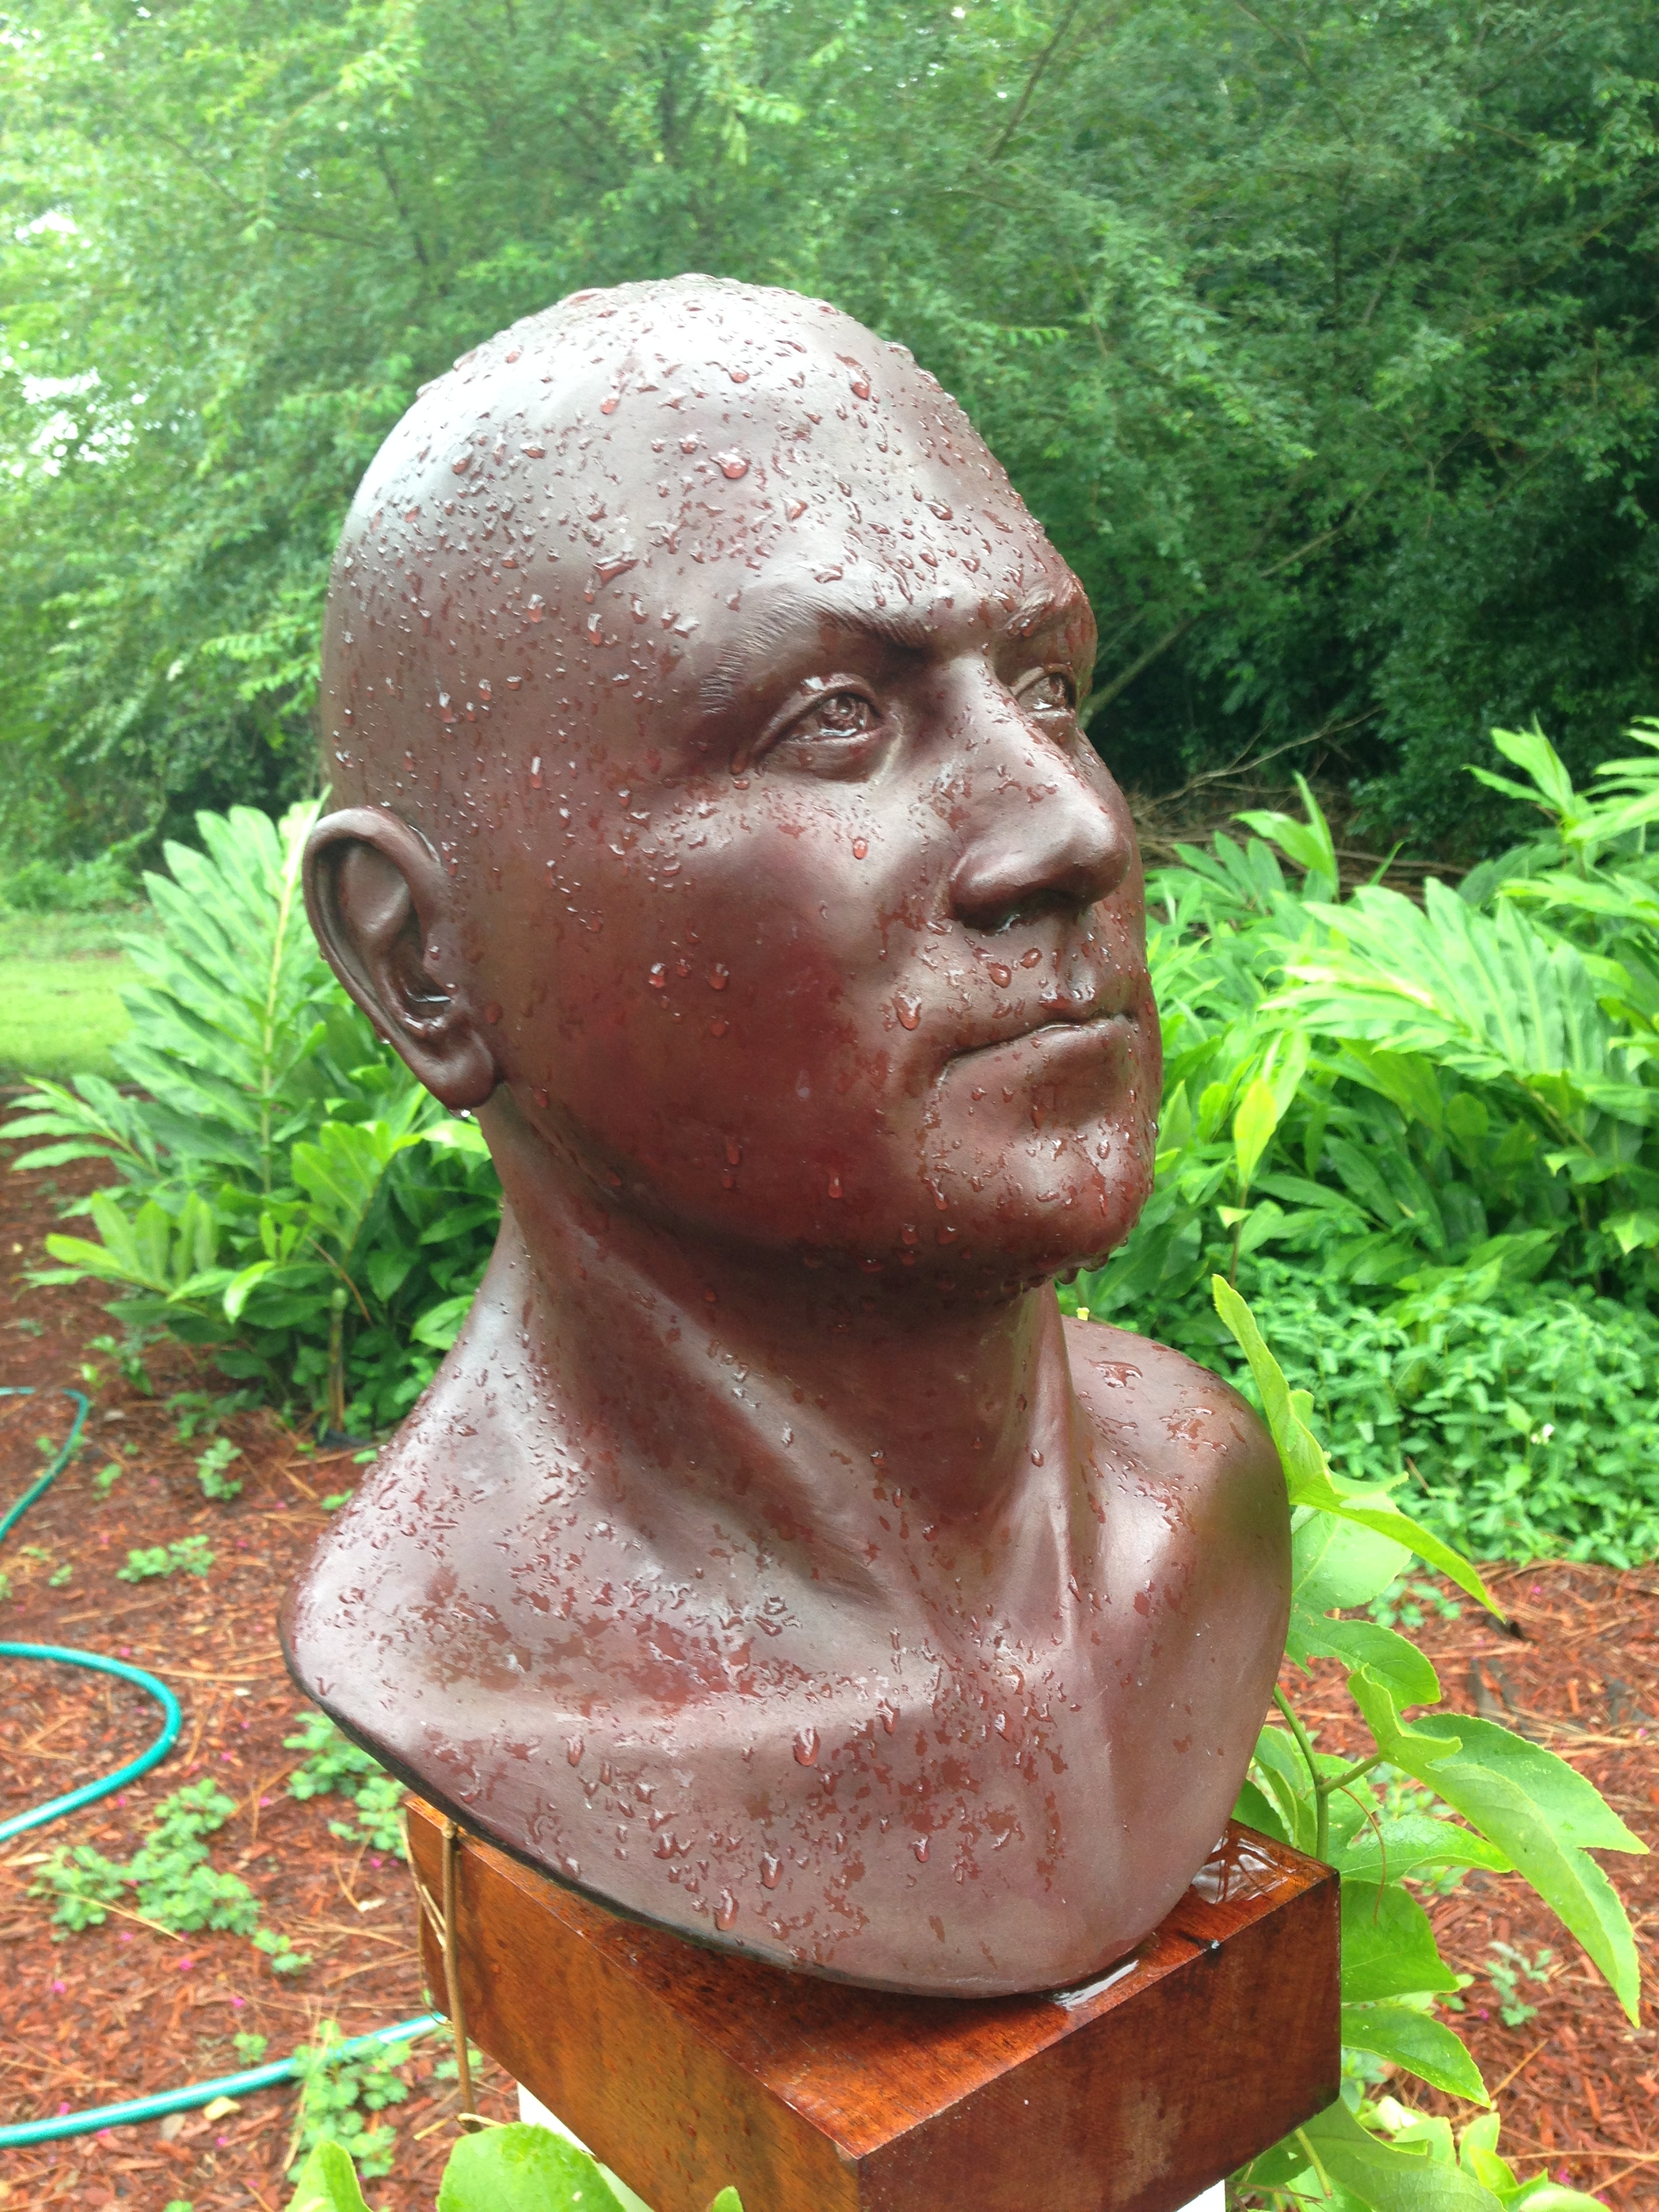
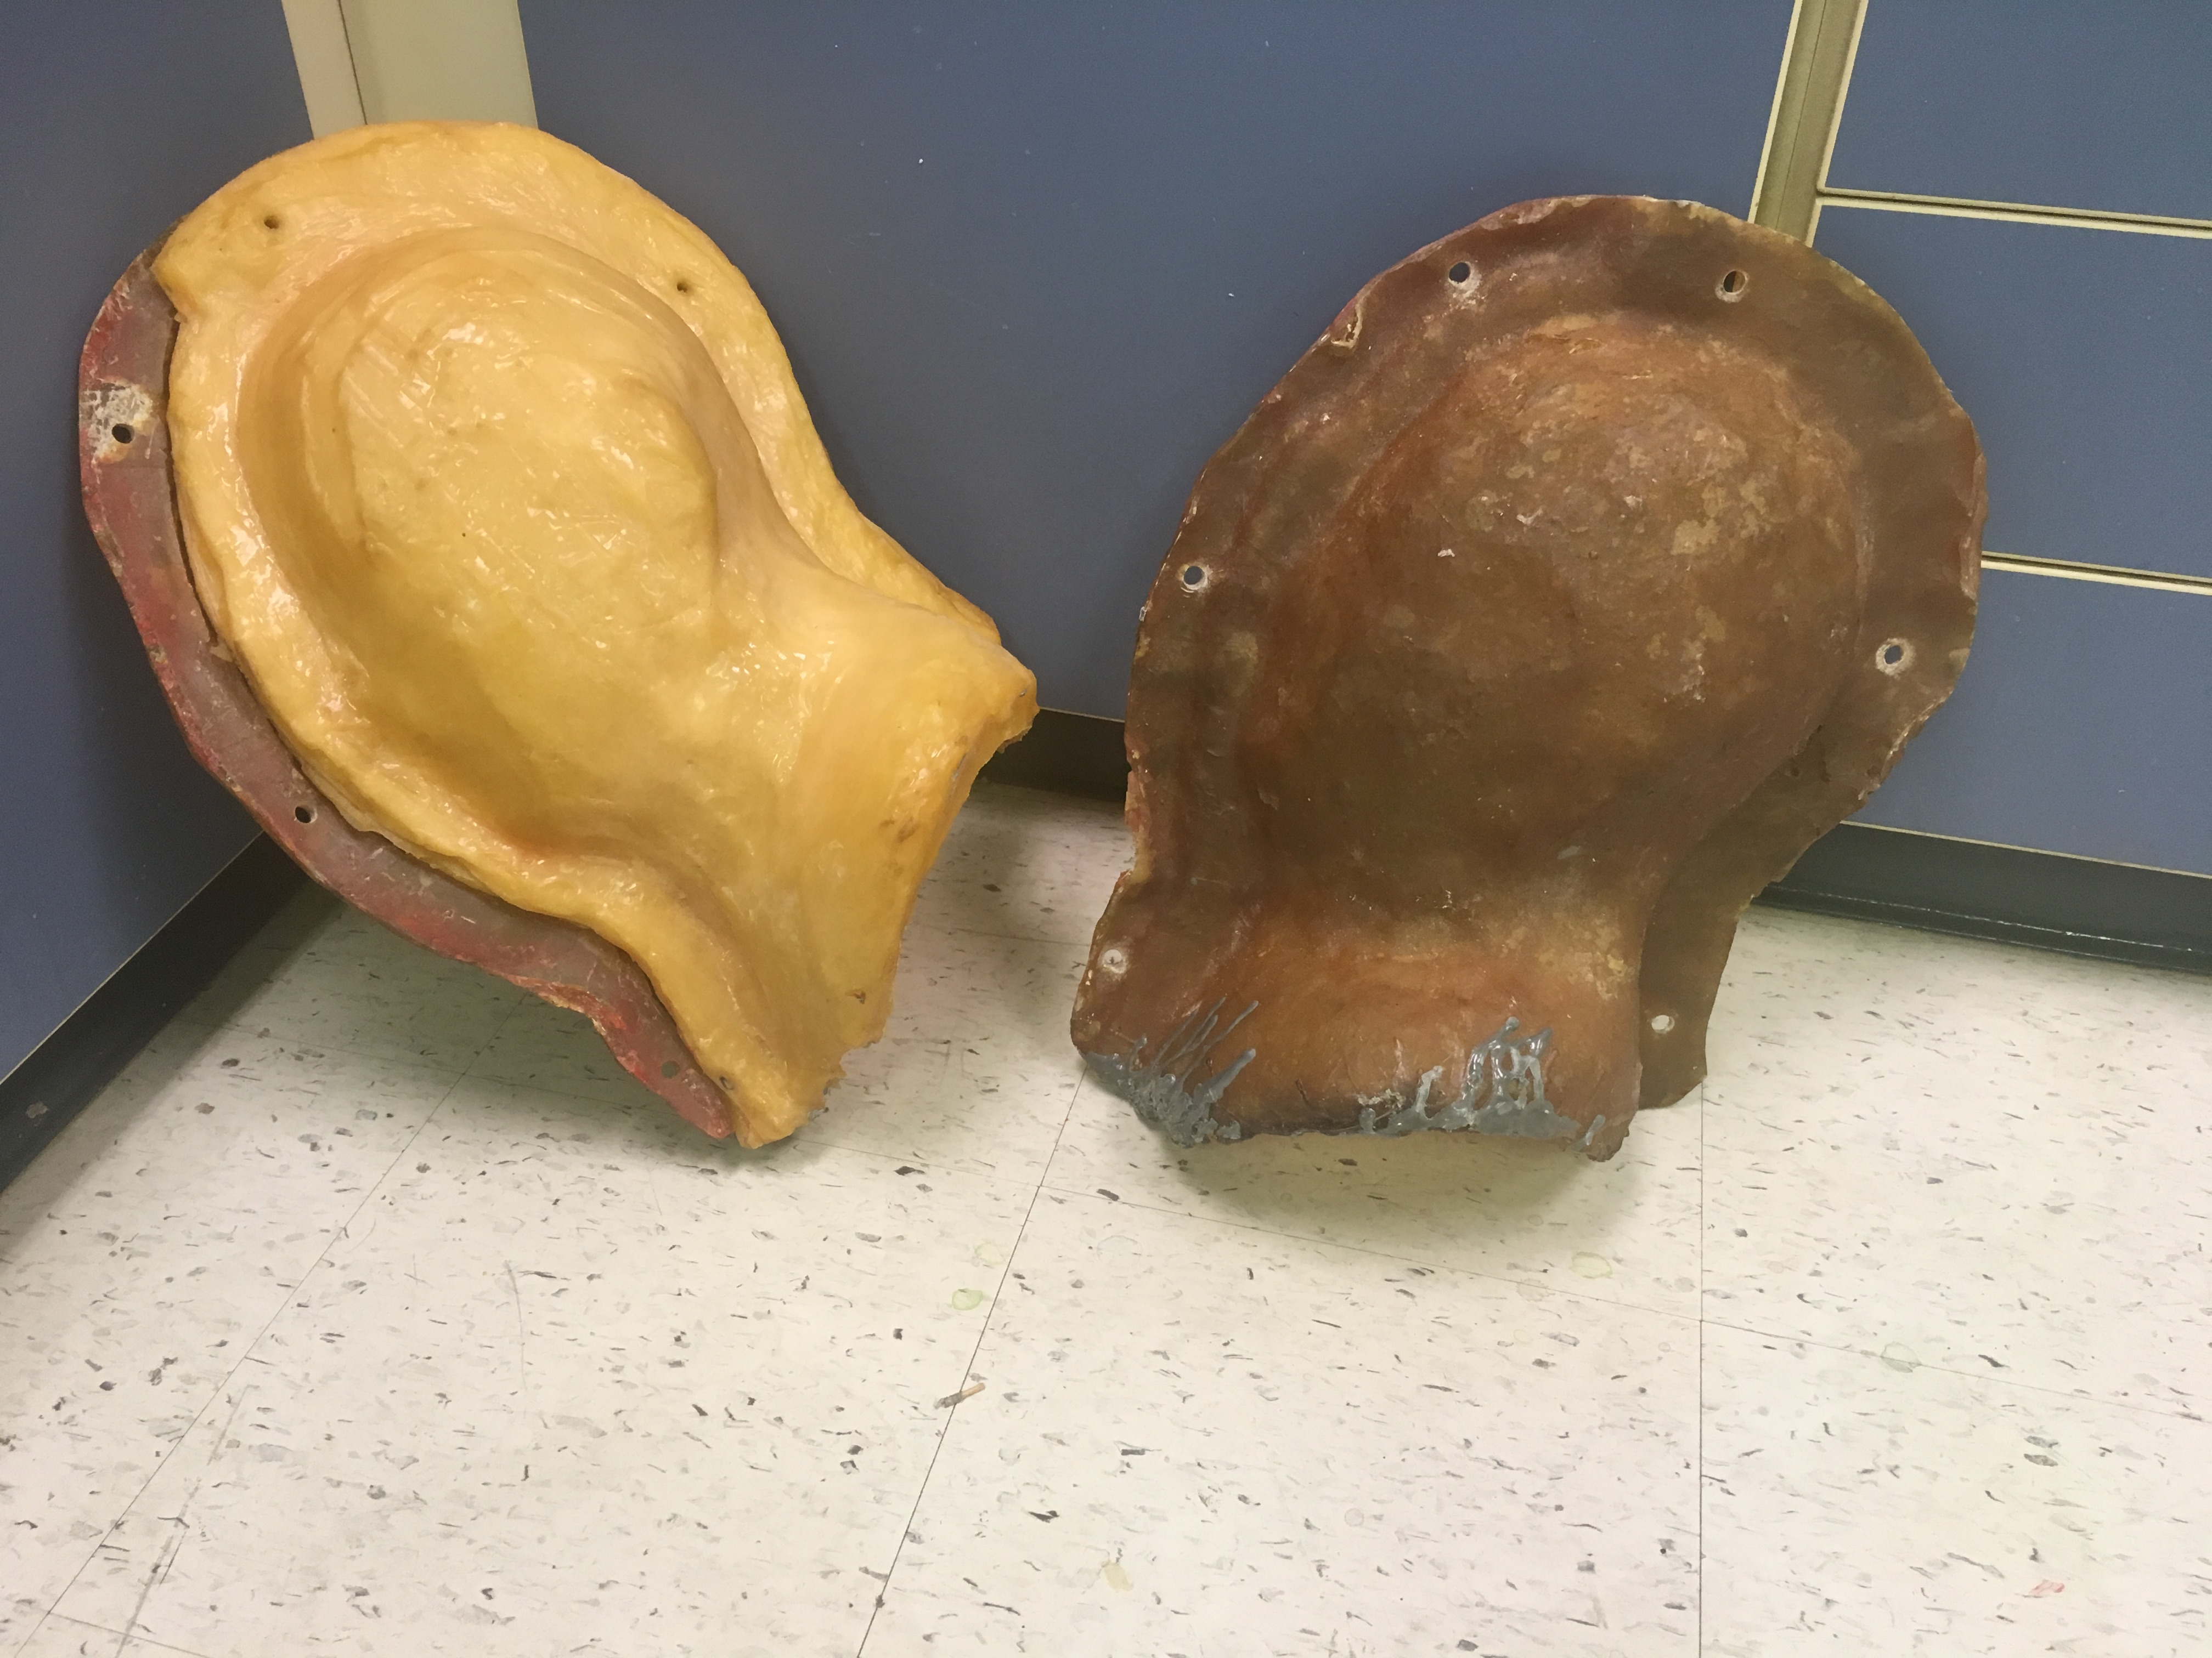
This is the mold for a portrait sculpture called “George”. It has a fiberglass mothermold. Since the silicone can be flimsy, the purpose of the mothermold is to hold everything in place.

Slide 15
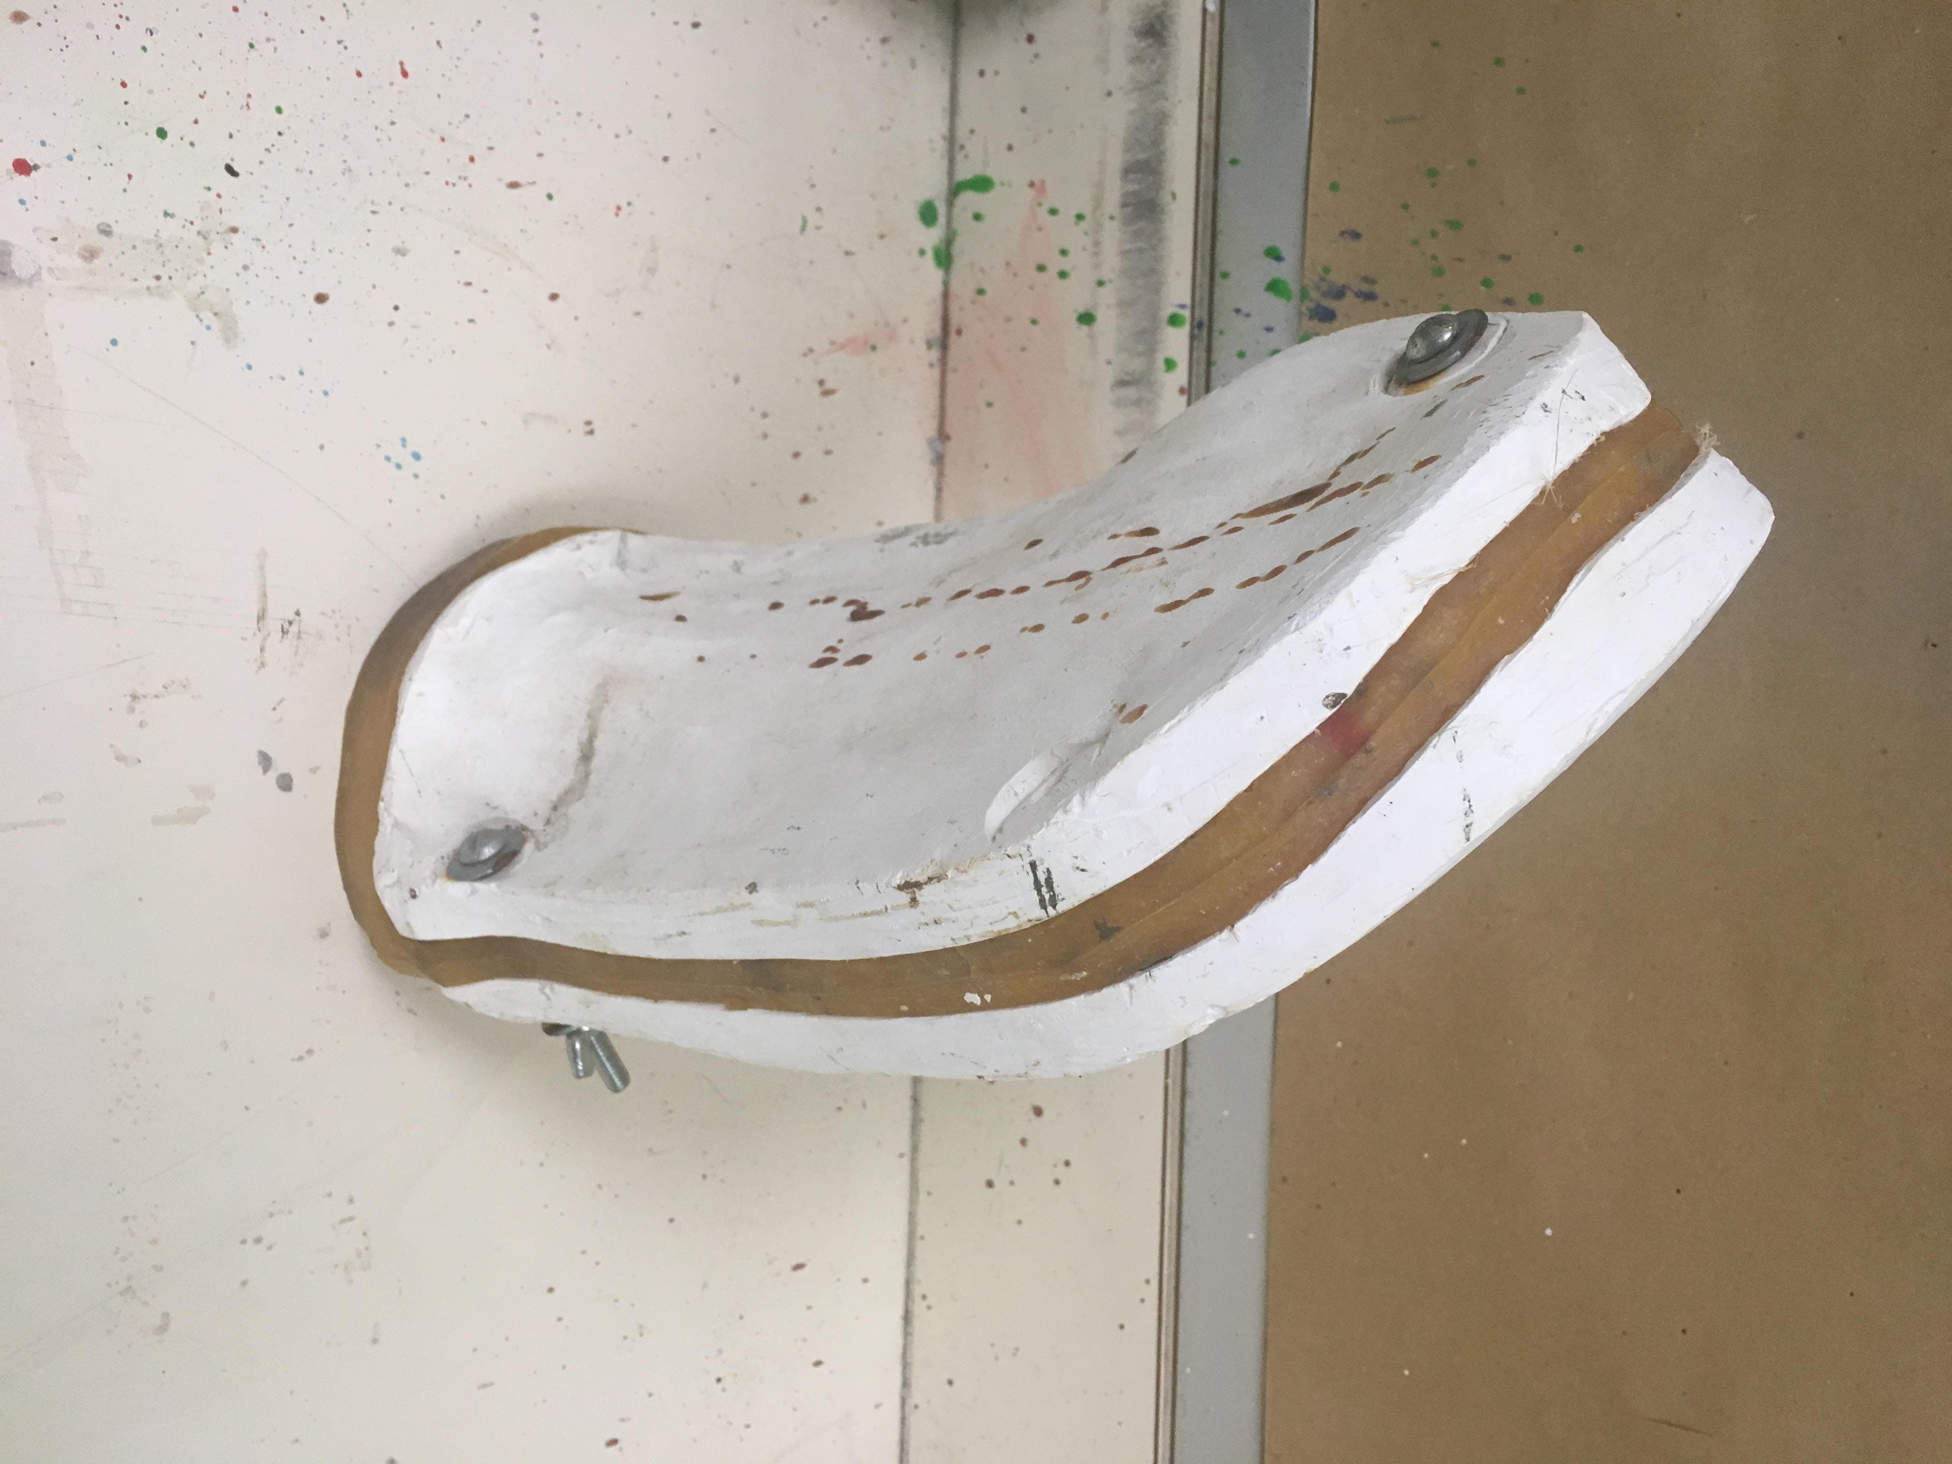
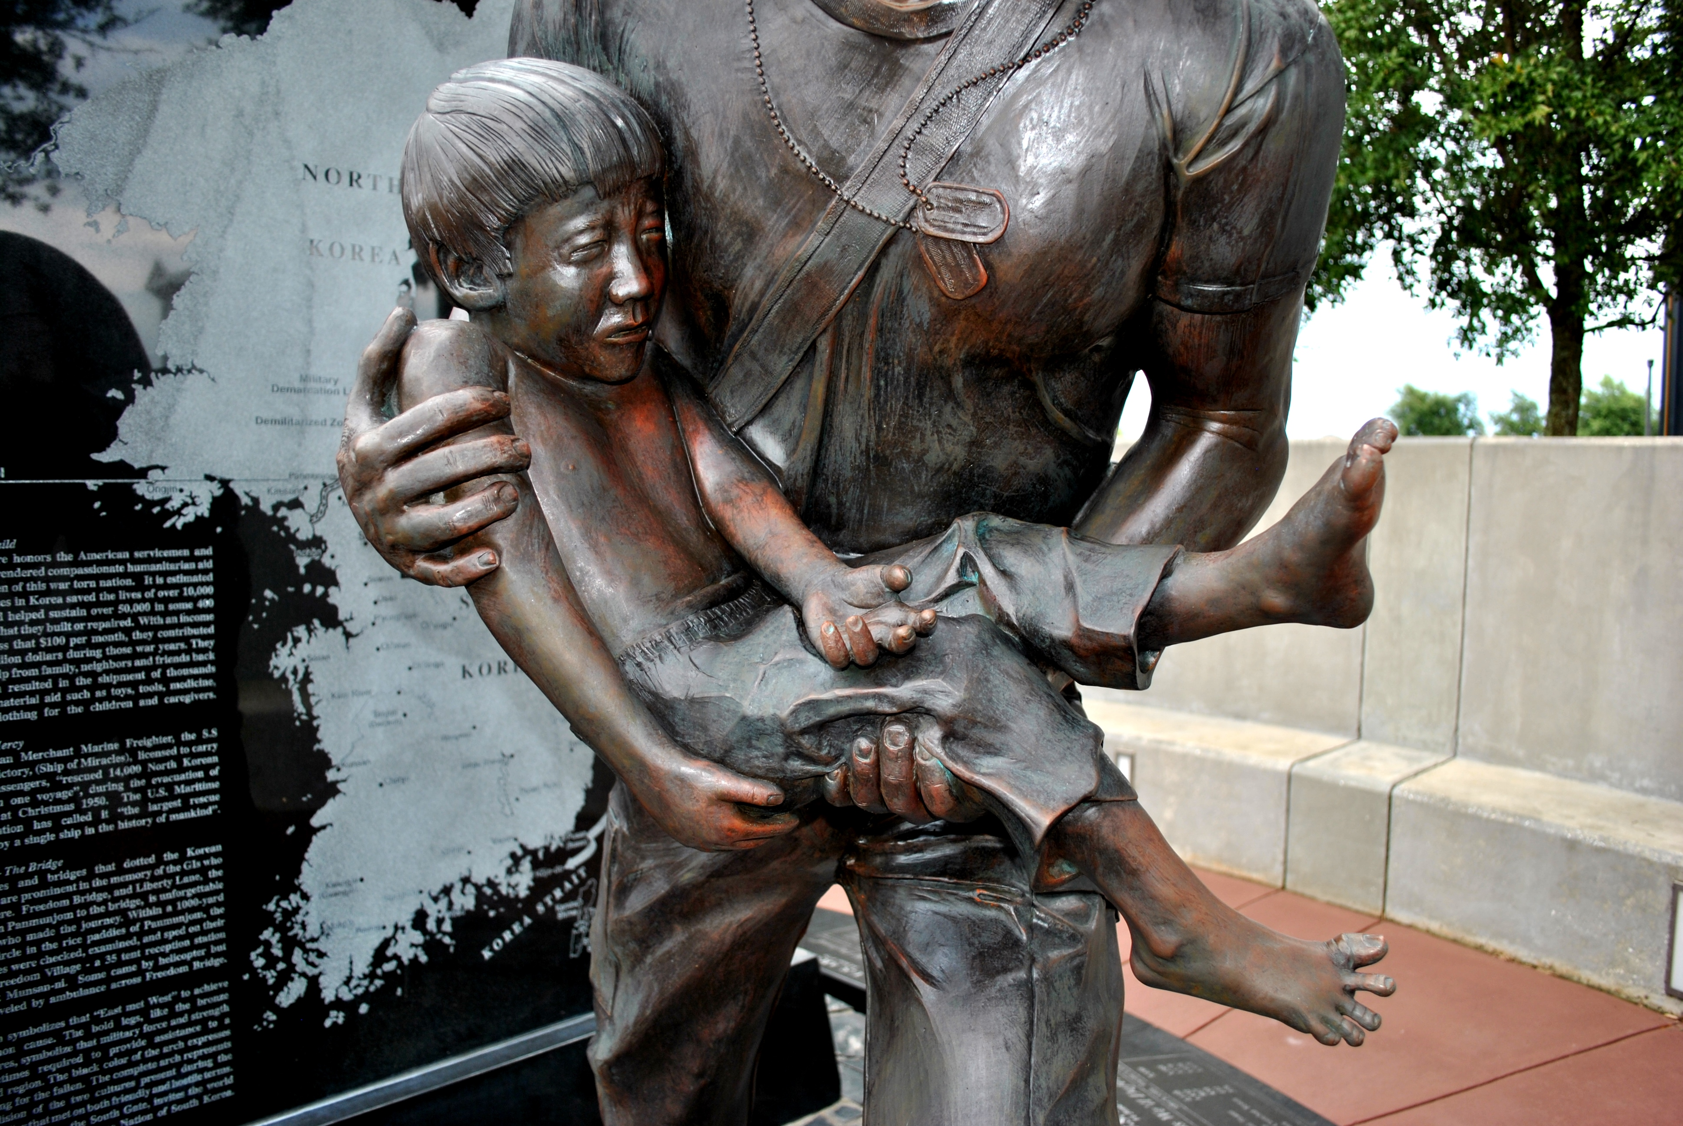
This is the mold for the left hand of the boy in this photograph. It has a plaster mothermold. This sculpture is part of the Korean War Memorial.

Slide 16
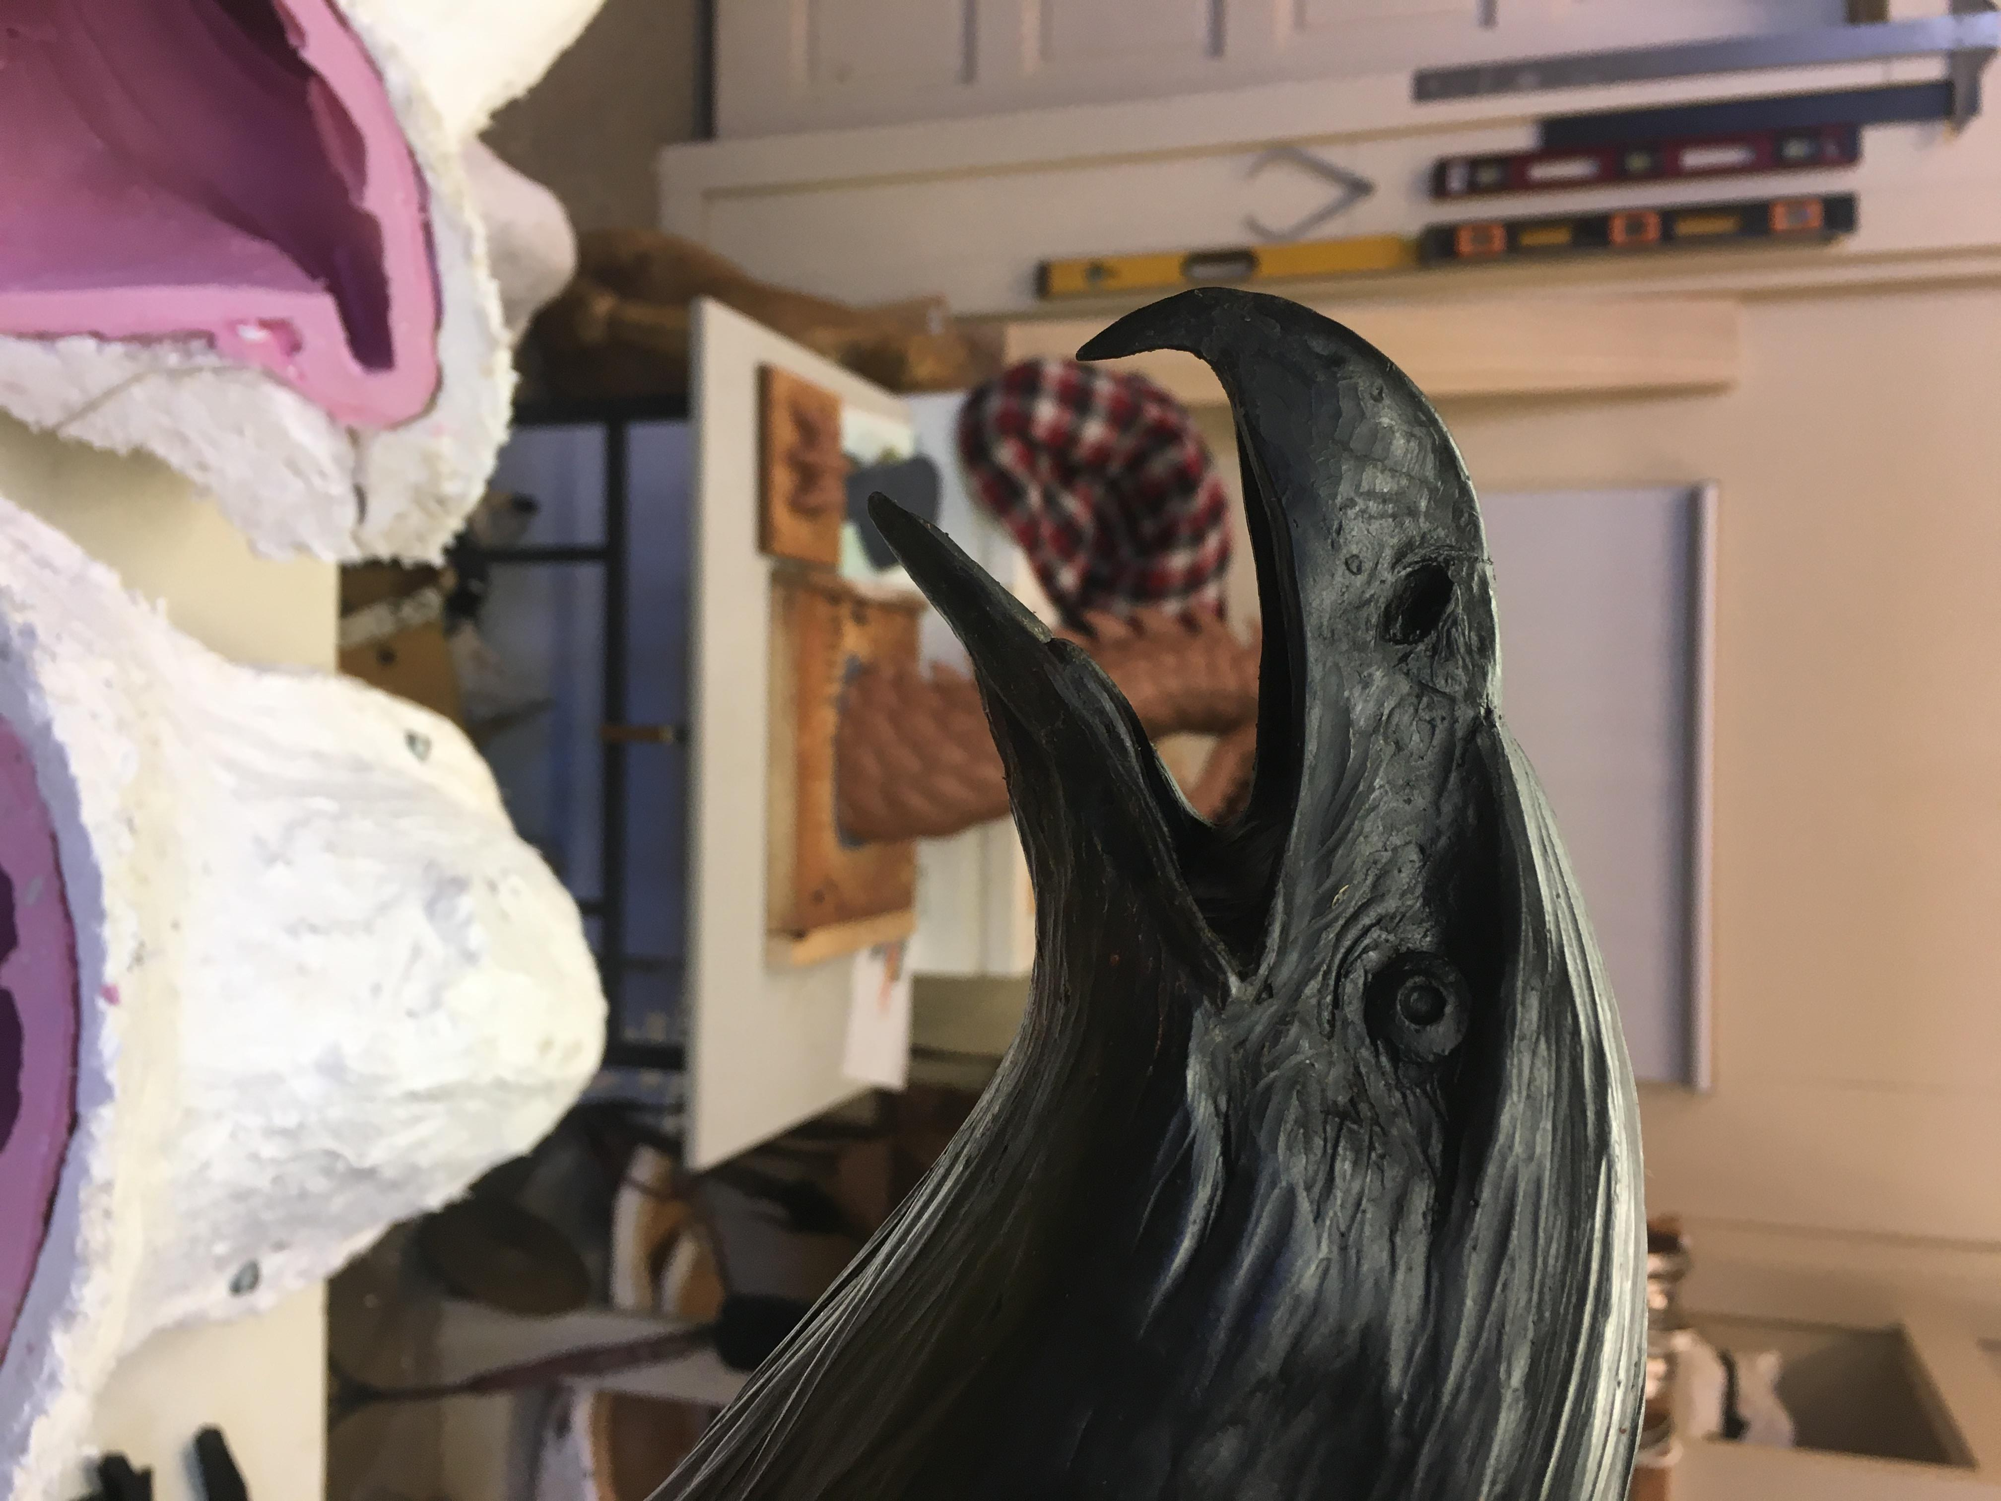
The next phase of production is called the “wax” phase. Wax is heated to liquid consistency and either painted into the silicone molds or poured in. The objective is to create a hollow shell with an even thickness of about ¼ inch. The surface takes on an exact image of the mold, so it looks exactly like the original clay sculpture. Keep in mind that a particular sculpture can have more than a dozen separate molds. The end product feels a lot like a chocolate Easter bunny; it is hollow and fragile. This is a good opportunity for the artist or the foundry to fix any flaws in the wax. This is called wax “chasing.” Or, big changes can be made. The mold for this eagle’s head had a closed beak. I was able to open the beak and use more wax to actually sculpt inside the eagle’s mouth during this wax stage.

Slide 17
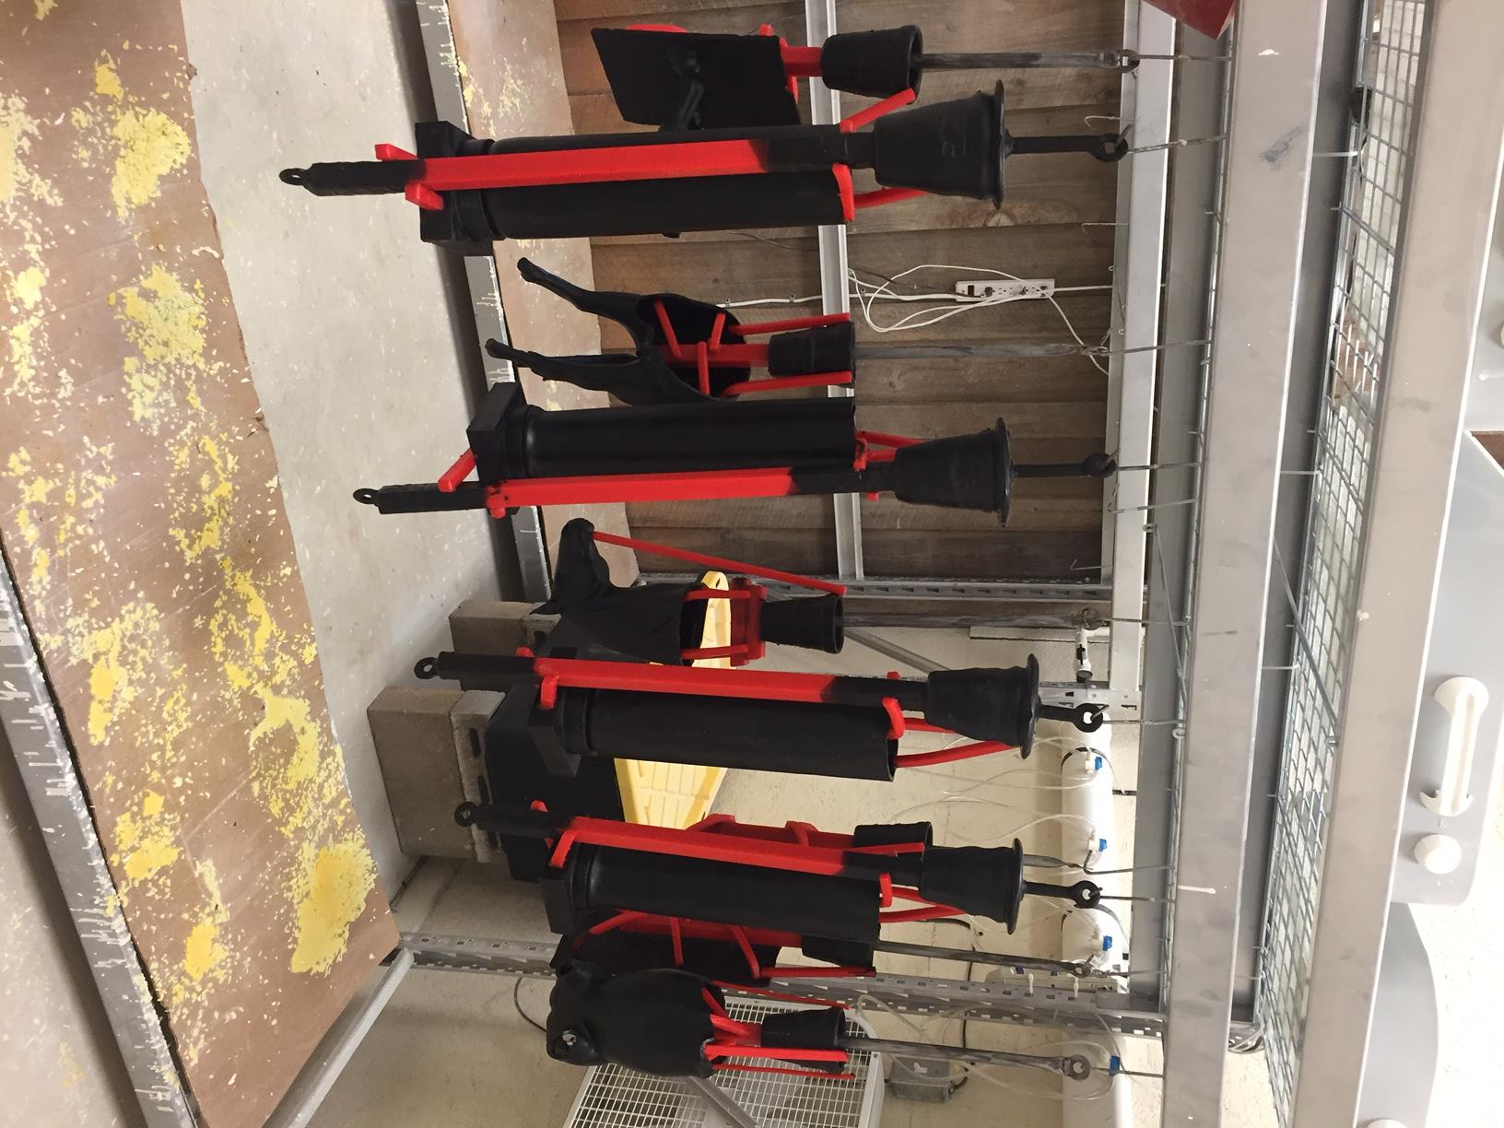
Next, each wax element must be “sprued” which means tubes of wax are attached, including a cup. The cup provides the place to receive the molten bronze, and the sprues provide structure and give the bronze a highway to travel so as not to trap gases. This process of bronze casting is called “Cire Perdue” or “Lost Wax.” The reasoning will become evident in the next few slides.

Slide 18
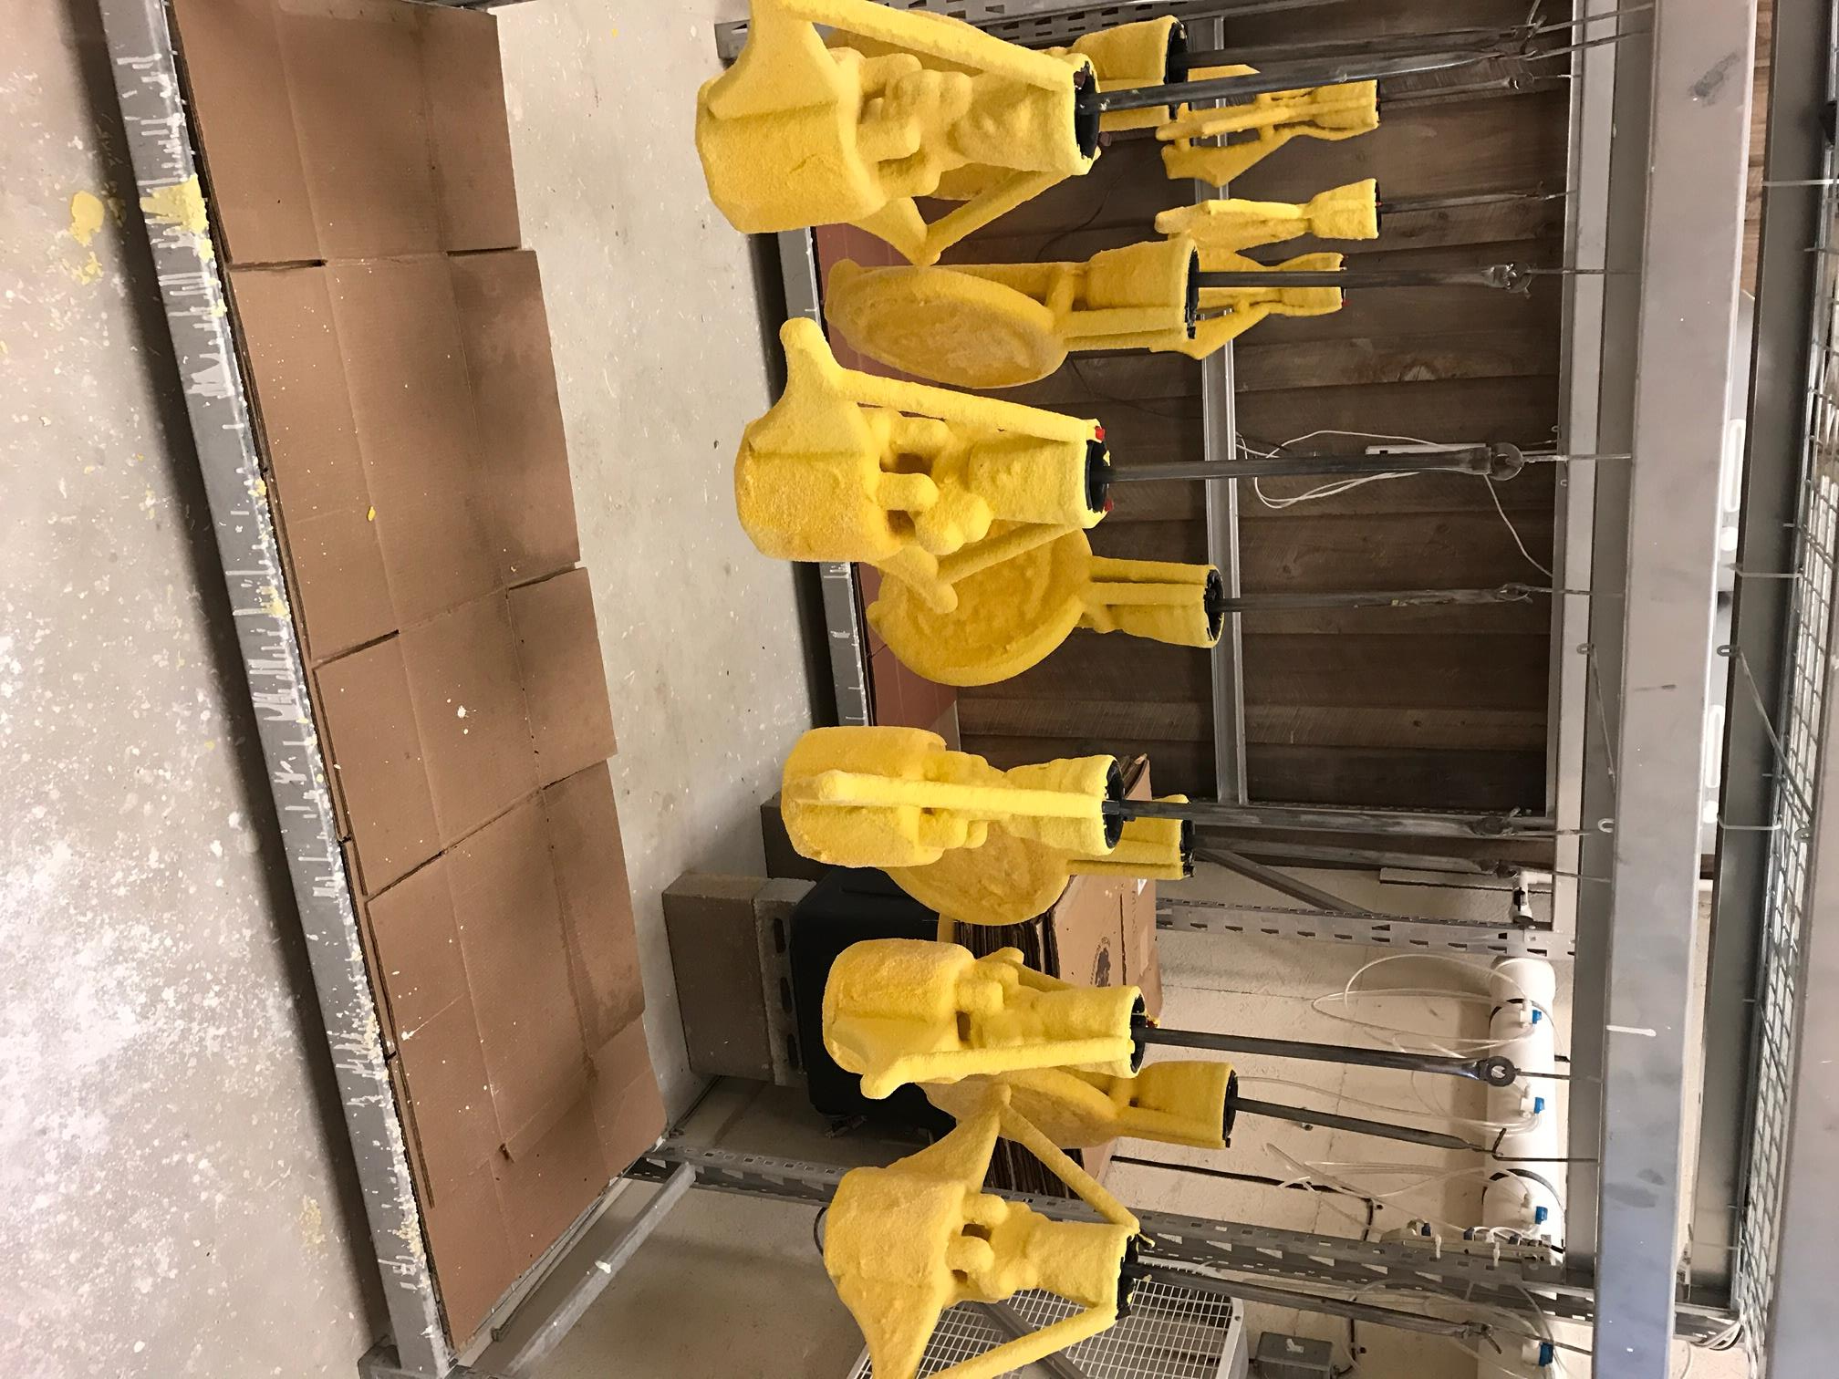
These sprued wax elements are then repeatedly dipped into vats of “slurry.” Slurry is like ceramic slip –that is, liquid clay– with sand mixed in for extra strength. Slurry baths must be constantly mixed to avoid settling and to maintain consistency. The pieces must build up the “ceramic shell” gradually. This phase of the process takes two days to build and to dry. If it is rushed, and something bad happens, it’s back to the wax room and all of that effort is lost. The next phase is called “burnout,” where these pieces are turned upside down in a large oven and the wax is melted out. This is why the process is called “lost wax.” Once the wax is melted out, the cavity is left to receive the molten bronze.

Slide 19
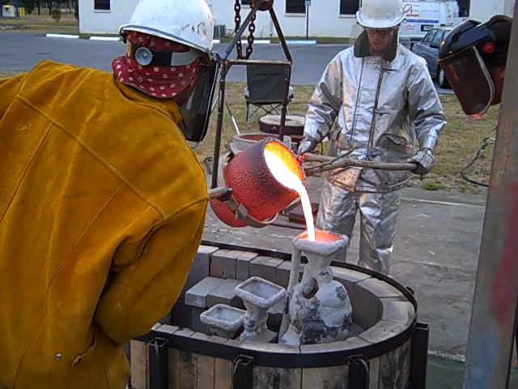
This is the part that everyone is most familiar with- the pour. Bronze is heated to a molten state in a crucible. In this picture, you can see the ceramic shell that is now very hard- hard enough to receive molten bronze and not break (hopefully)! The ceramic shell is empty because all of the wax was melted out. You can also see the cup that I mentioned in a previous slide. Notice that it takes two men to control the weight of the liquid metal. Also notice that they are wearing fire-resistant clothing. This is the most dangerous part of the casting process.

Slide 20
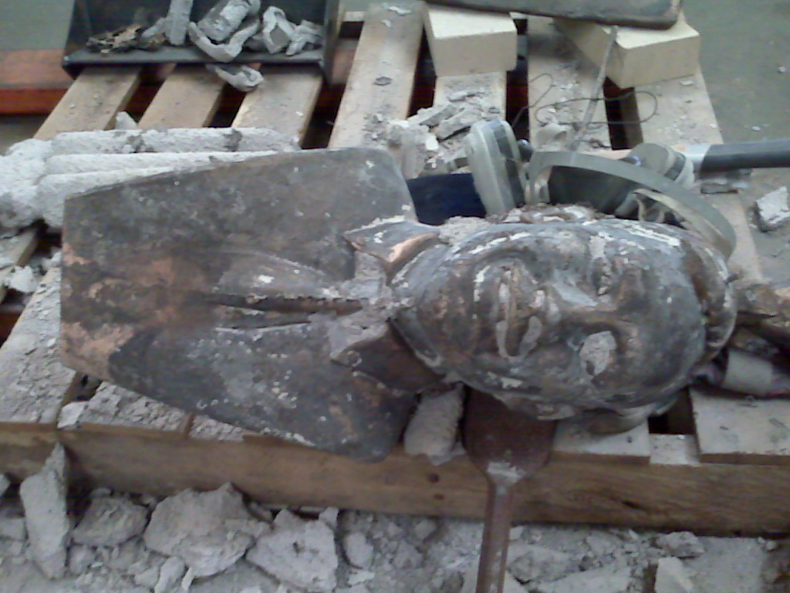
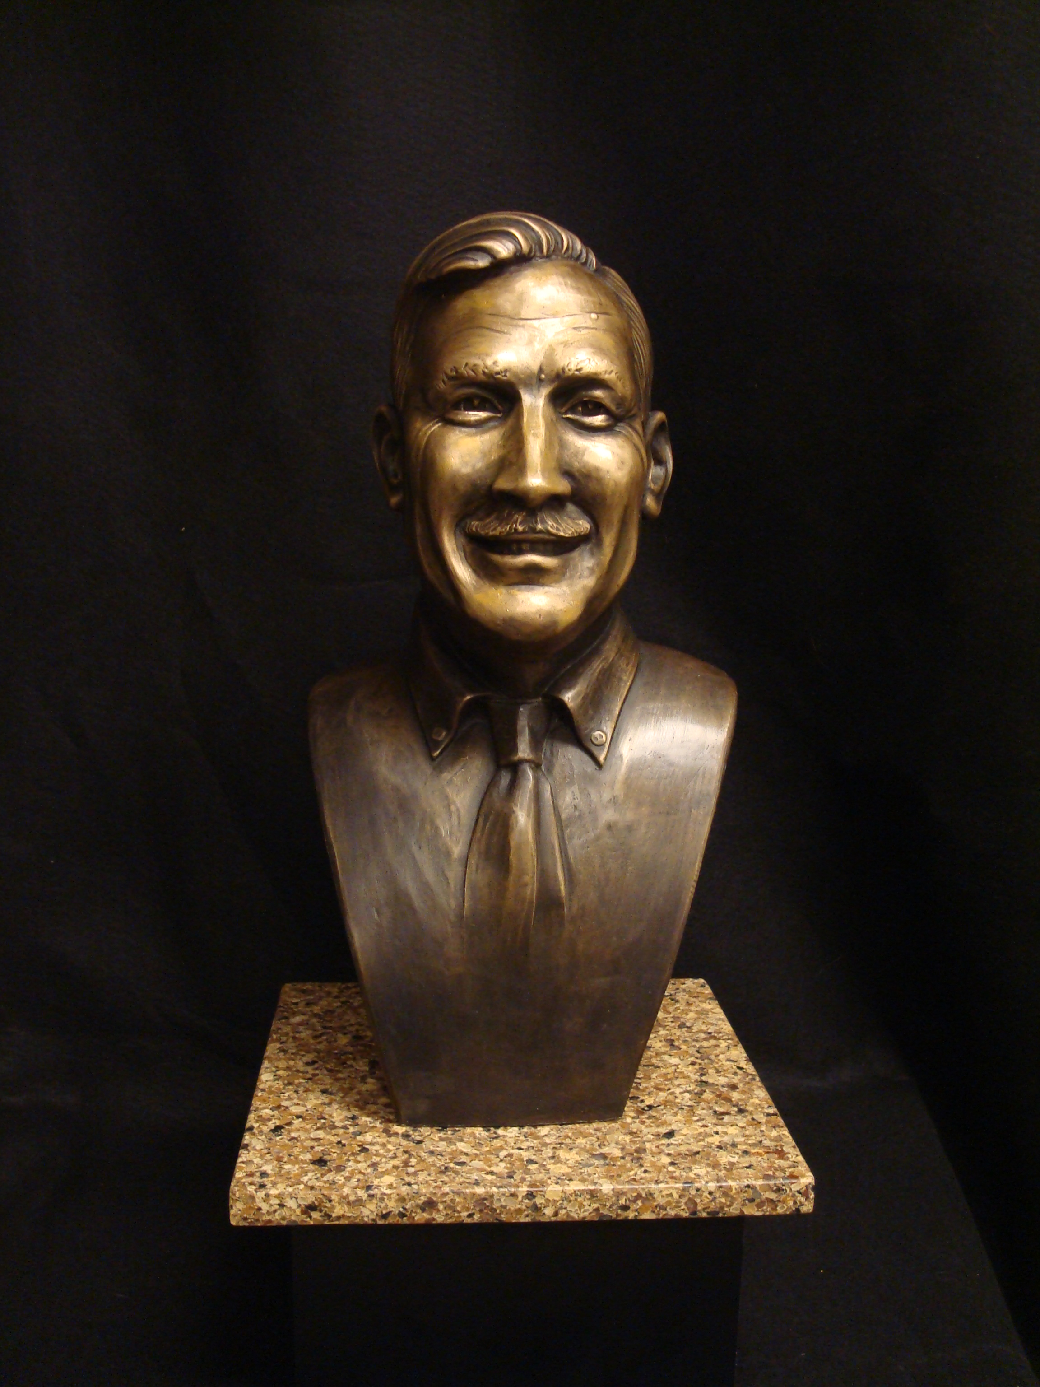
This doesn’t look like much, but it is the result of the previous slide. This is a portrait I created of “Frank” (see finished bust below). Once the bronze cools, all of the ceramic shell must be busted away with hammers. Then all of the little bits of shell are chiseled off. Eventually, everything will be sand-blasted.

Slide 21
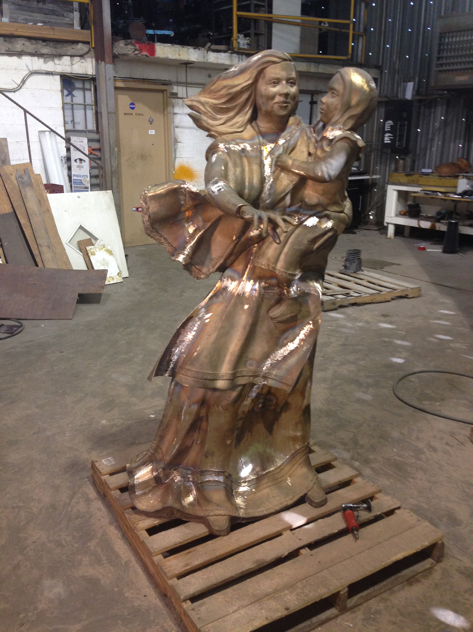
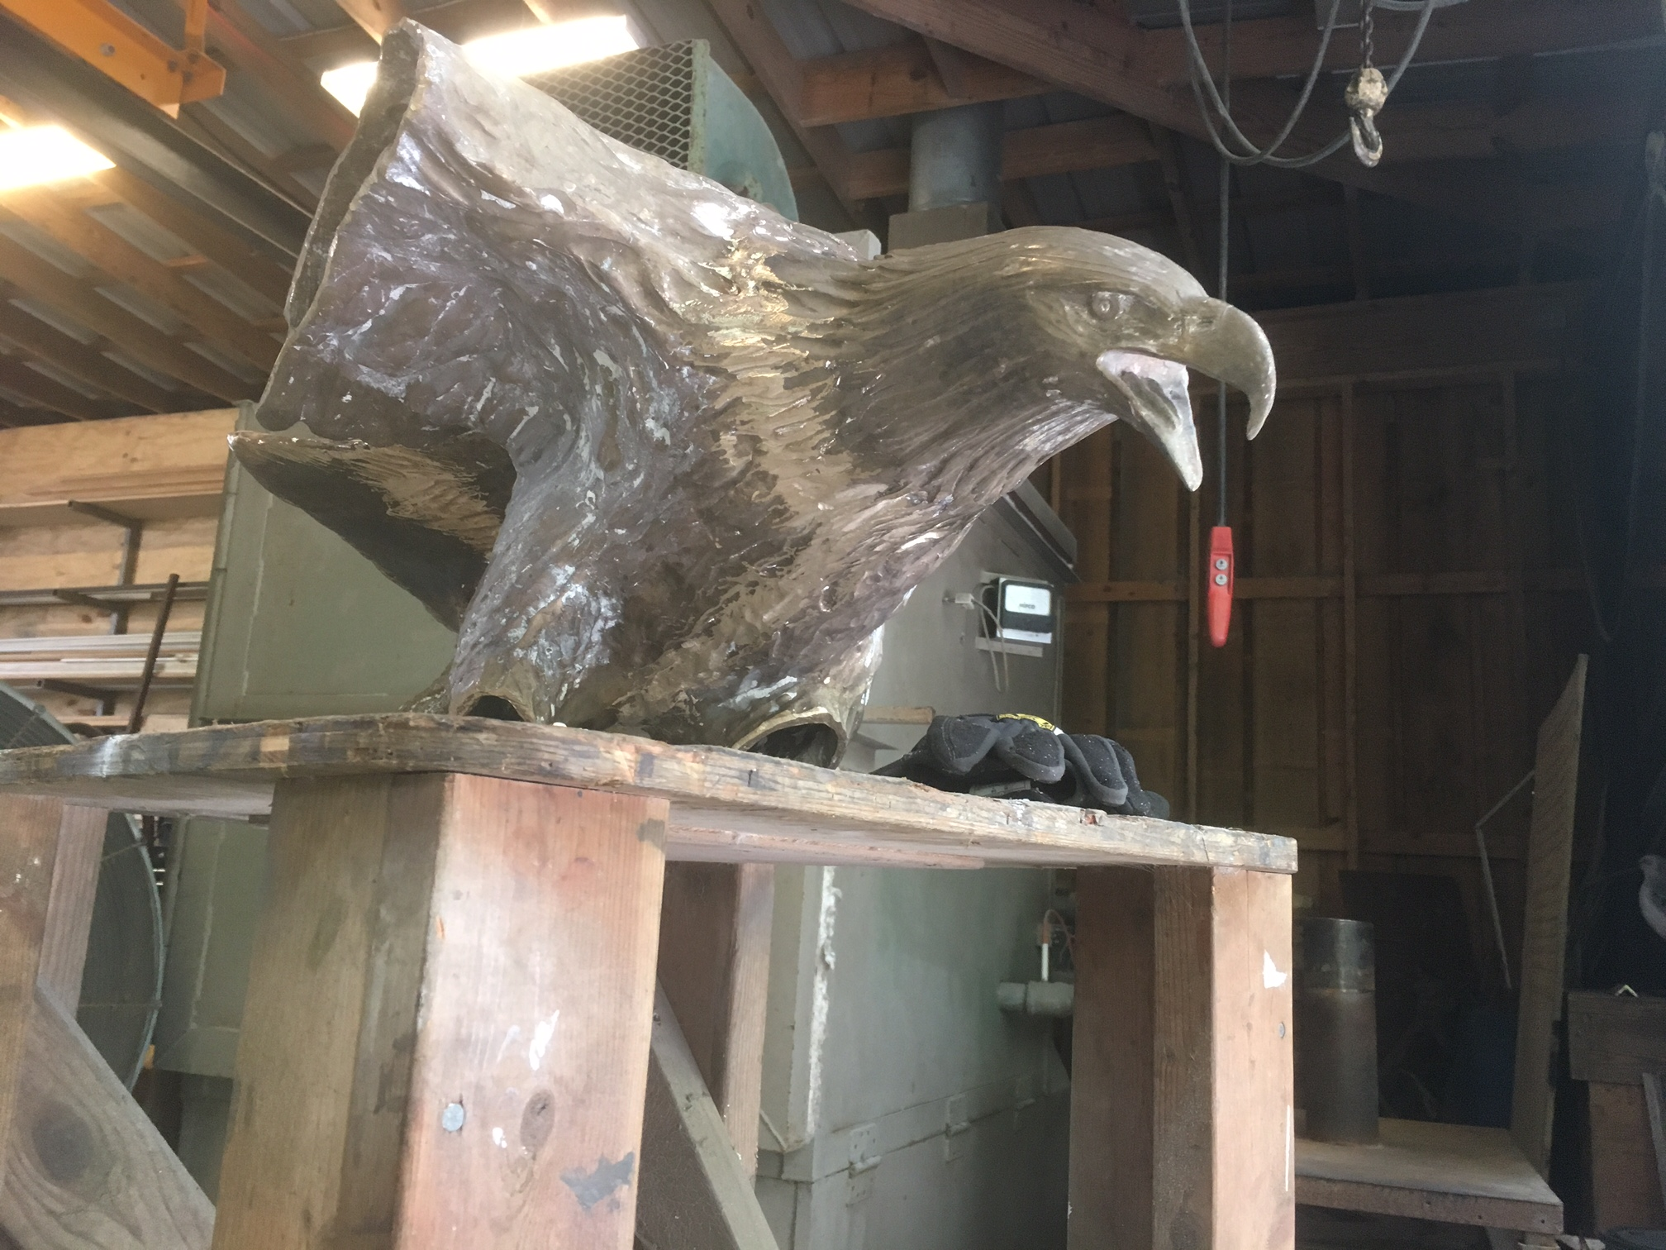
All of the separate pieces of each sculpture are then welded together with bronze welding rods. Below, you can see the eagle before his wings and talons were welded on. All of the welds then must be ground down until they become undetectable. This is called metal chasing just like with the wax.

Slide 22
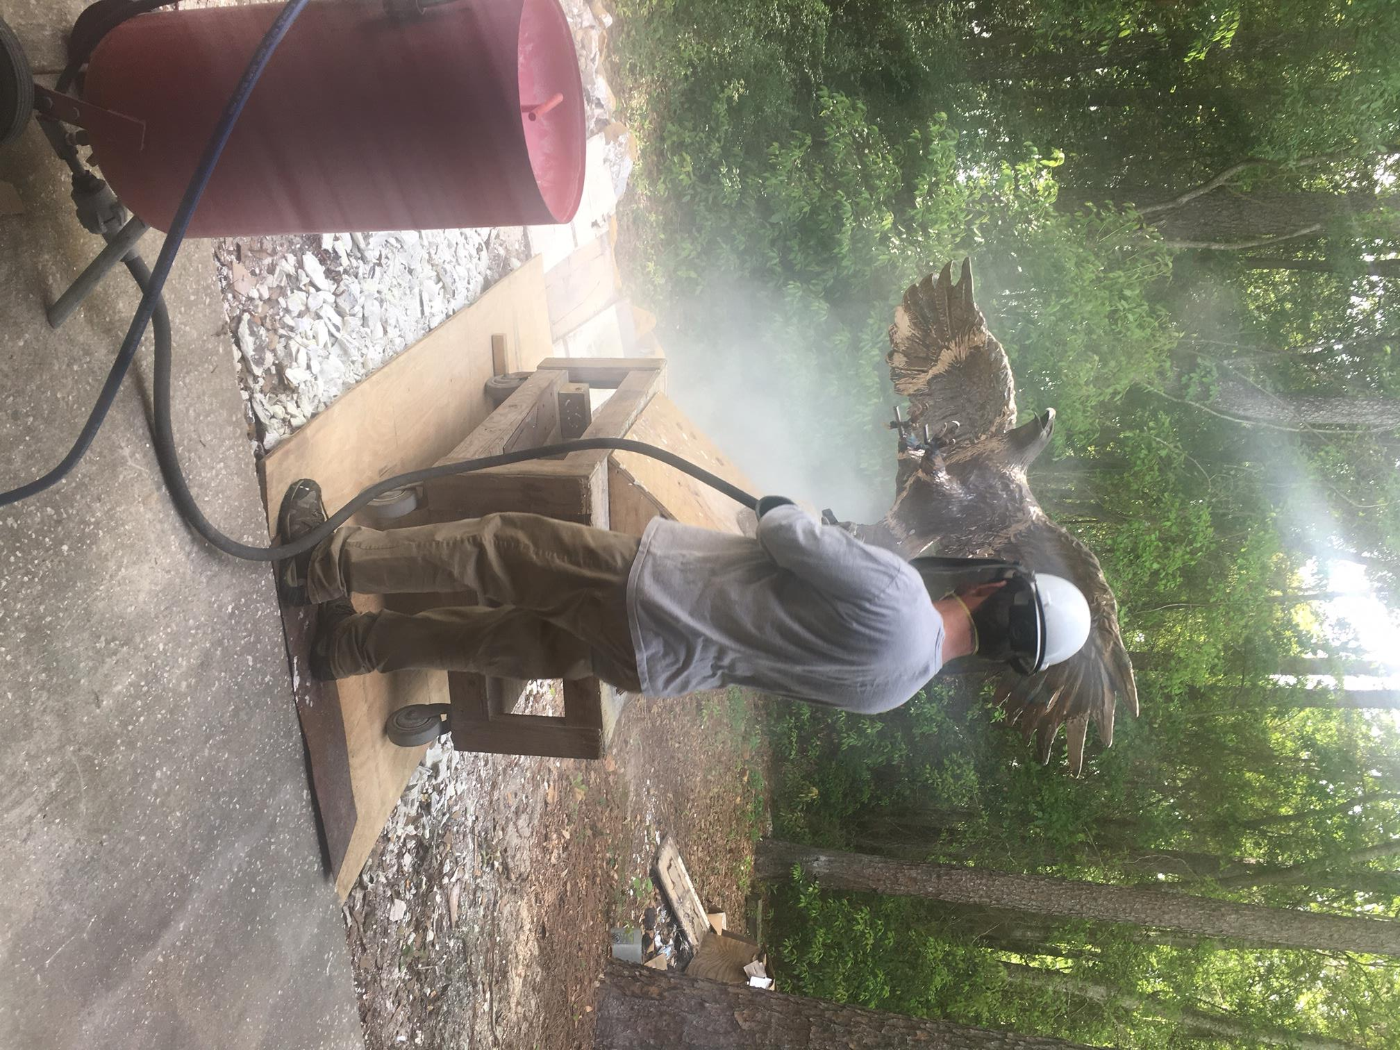
Any imperfections in the metal are corrected as part of the metal chasing stage. If there is a hole, it is filled in with metal by welding and then it is ground flush. One of the most difficult and time-consuming aspects of the metal chasing phase is whenever a texture must be recreated. It’s not enough to just grind a weld mark down. The weld mark must be texturized using a variety of grinding tools in order to replicate the texture of the surrounding areas. After all of the chasing is done to the satisfaction of the artist, the piece is sandblasted. Compressed air is mixed with sand and shot at the surface in order to ready it for the next step.

Slide 23
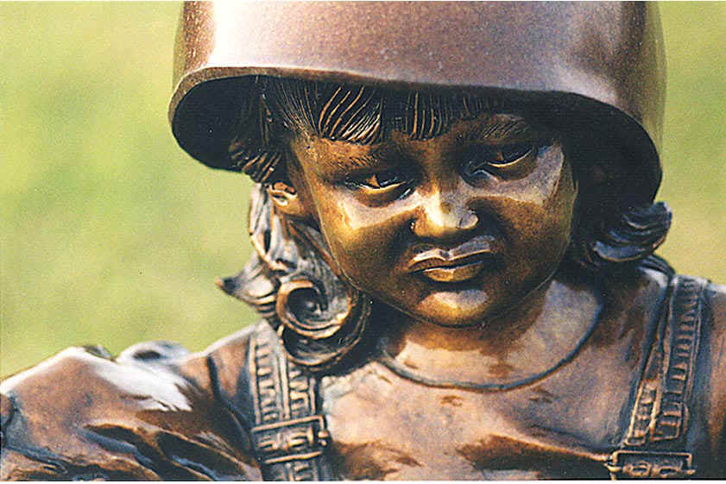
The next phase is called “patination”. The patina is the color of the bronze. Different chemicals create different colors. One example is Ferric Nitrate. It is mixed with distilled water in a spray bottle. The bronze must be heated by a torch so that the sprayed chemical will be absorbed into its “pores.” The excess chemicals are scrubbed away and then a wax is applied. Because the sculpture will be placed outside, the wax protects the surface from the elements. This particular sculpture was coated with lacquer.

Slide 24
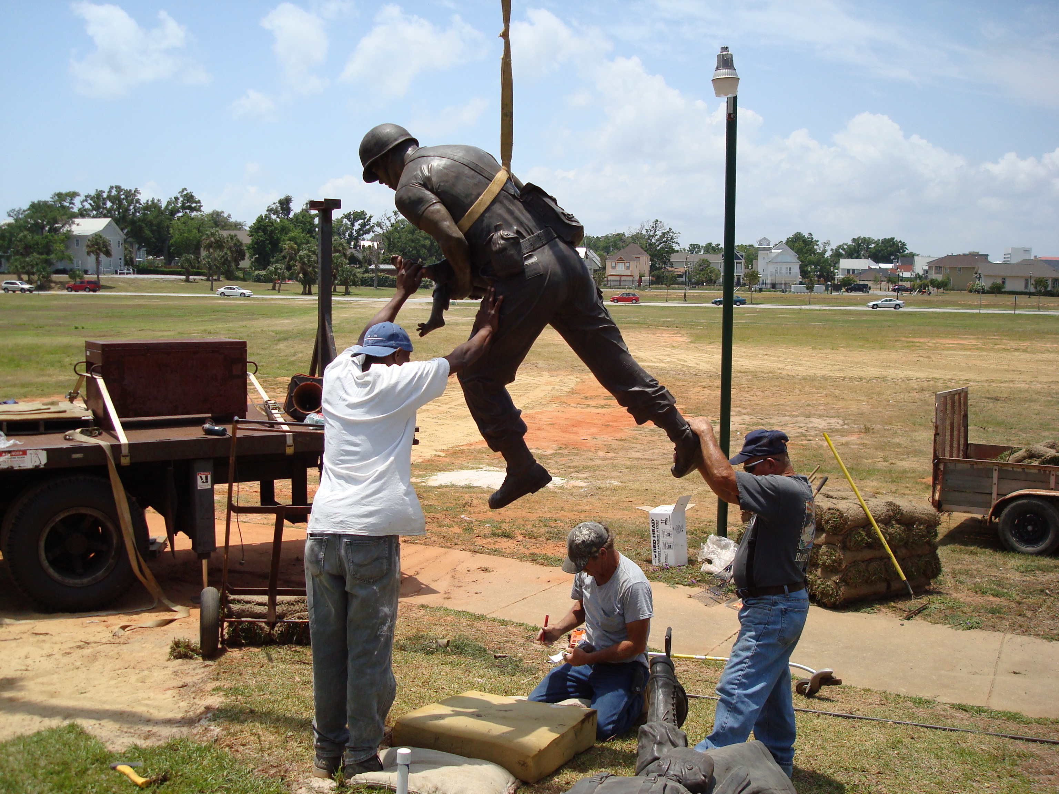
Installation
Once the sculpture has been waxed, it is ready for pick-up by the artist from the foundry. Some foundries will transport and deliver the artwork. My foundry is a full-service foundry. He actually transports and installs the sculpture! Installations vary depending on the size and complexity of the piece or the location of the pedestal or concrete slab that is receiving it. Most of the time, large nuts are welded to the base of the bronze and bolts are threaded into the nuts. Holes are drilled into the concrete and the sculpture is lowered into the holes for a “dry fit.” If everything is good, an industrial adhesive is pushed into the hole and the bronze is lowered again for permanent placement.

Slide 25
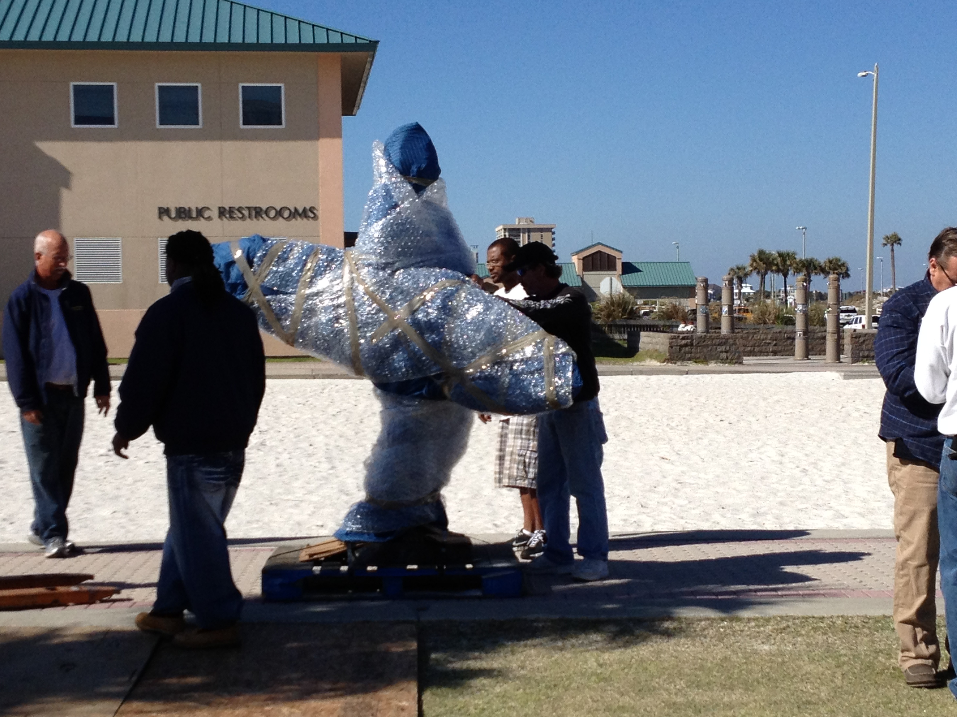
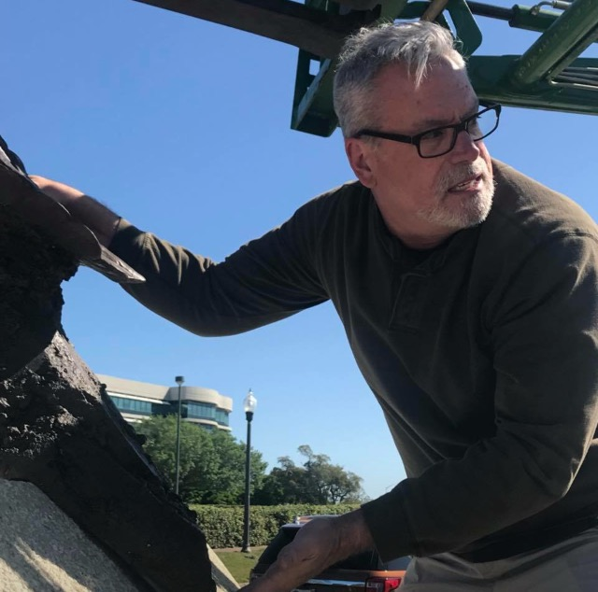
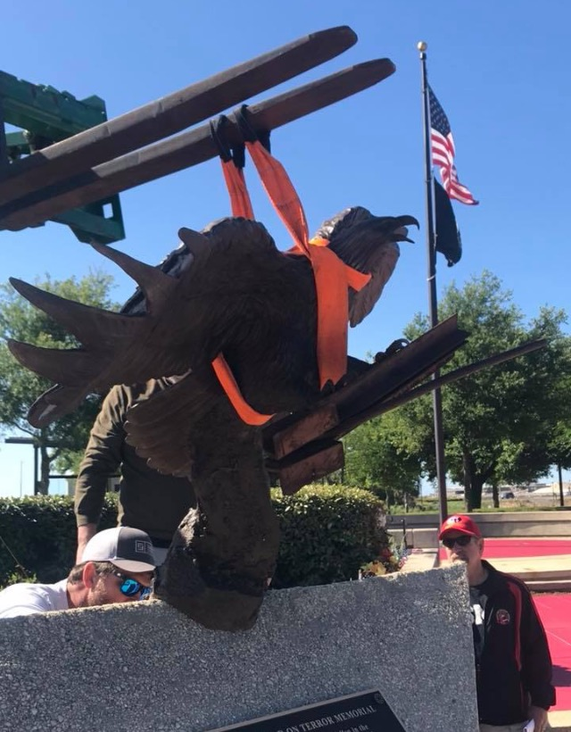
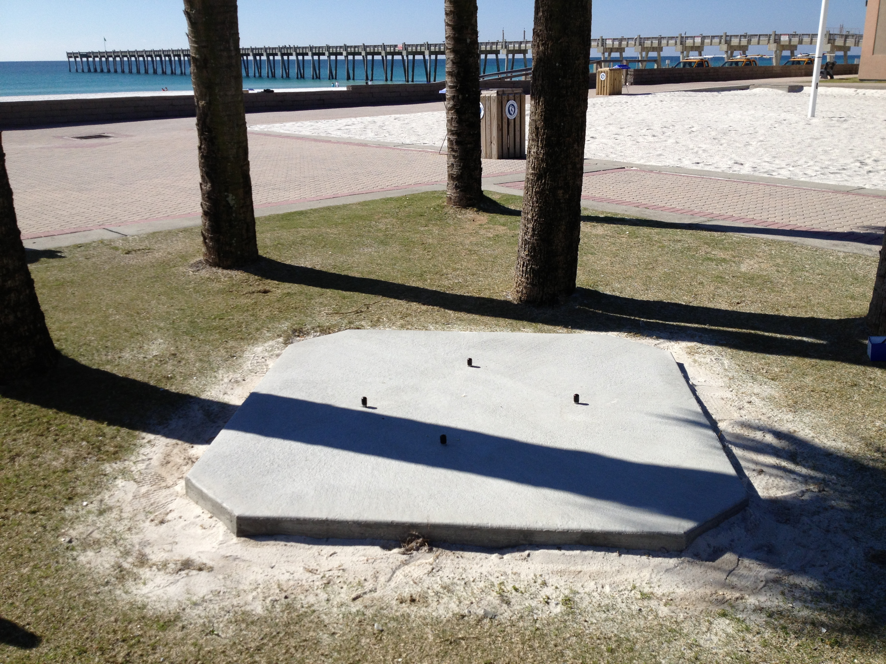

Slide 26
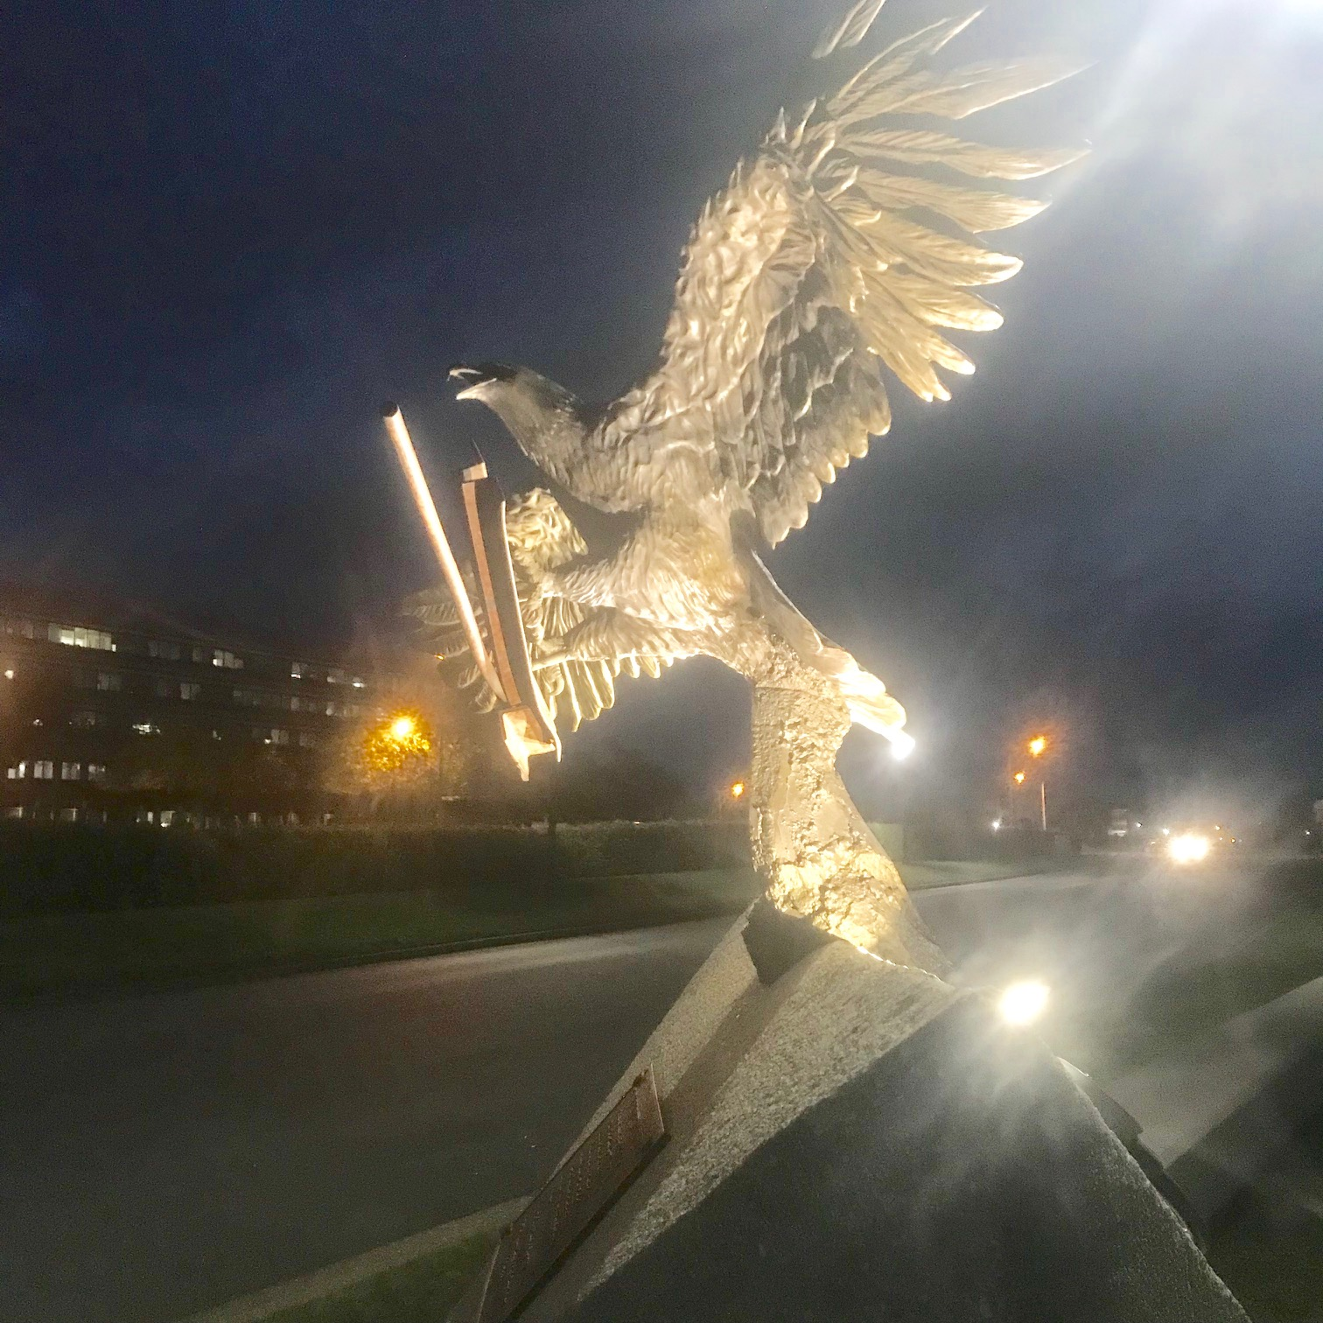
Well, that about does it. Other items that may be considered are lighting, plaques, landscaping, and benches. Most public sculptures also involve a press release and a public unveiling and dedication. Often, the artist is invited to these events and asked to give remarks.

Slide 27
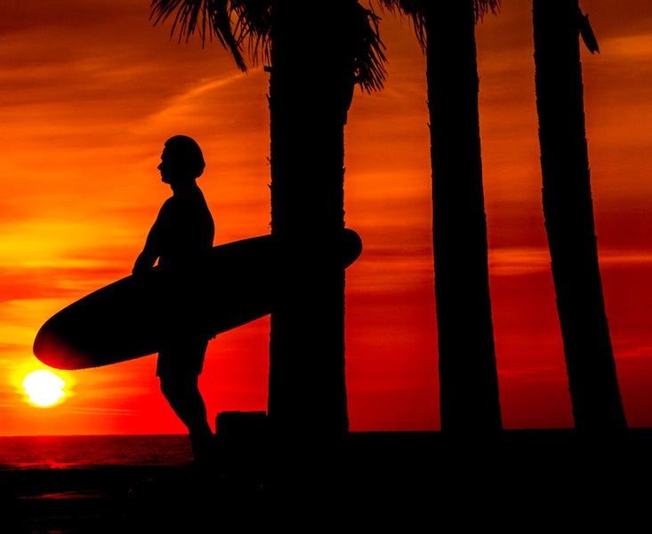
Yancy Spencer III Memorial

Slide 28
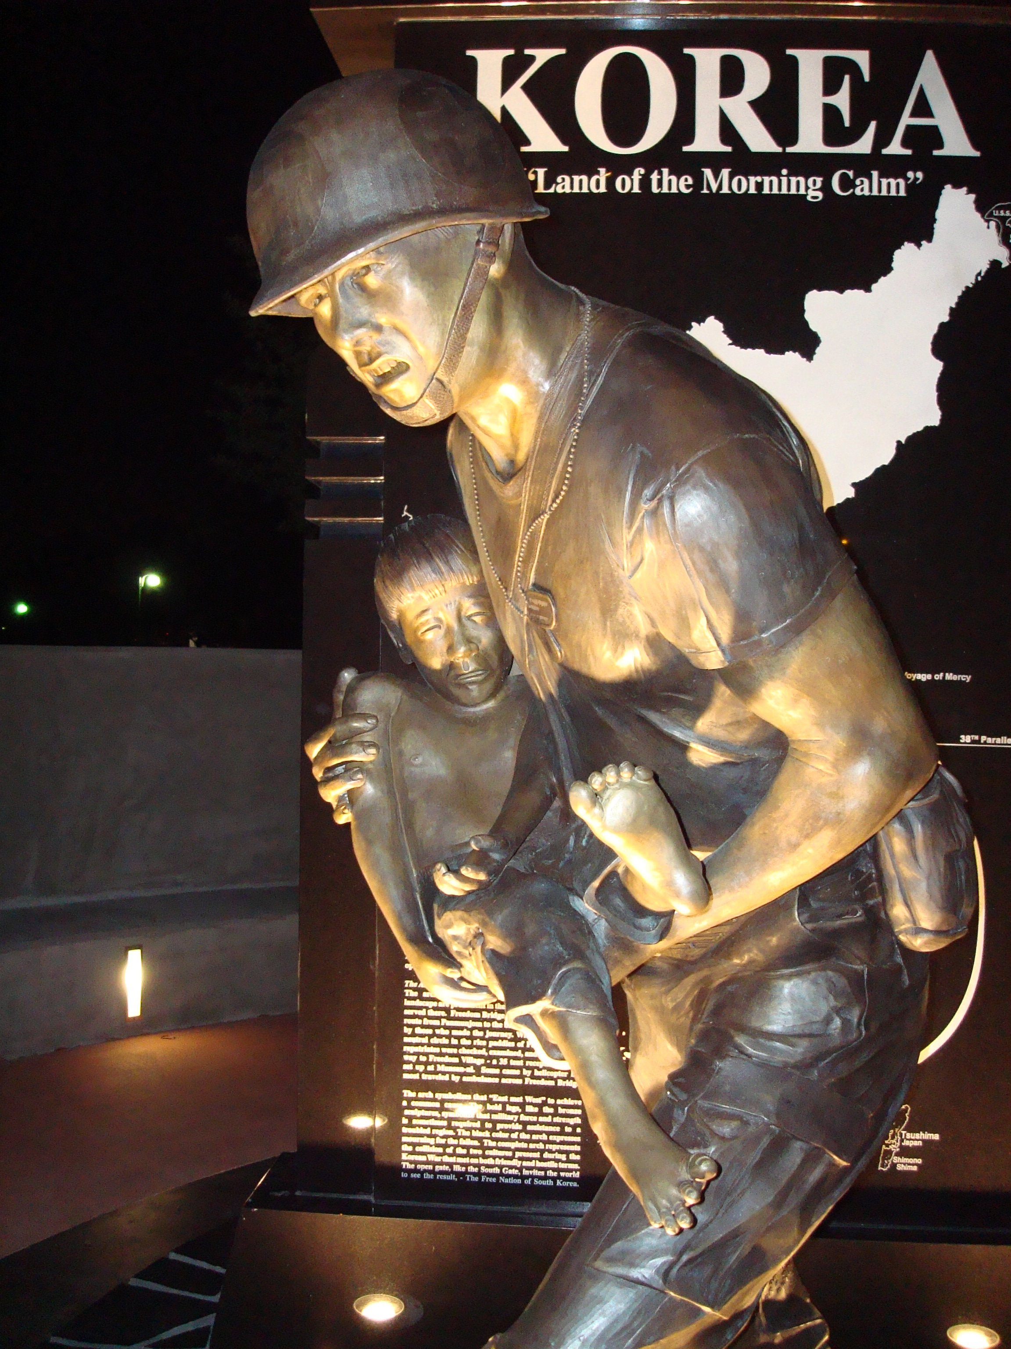
The Korean War Memorial

Slide 29
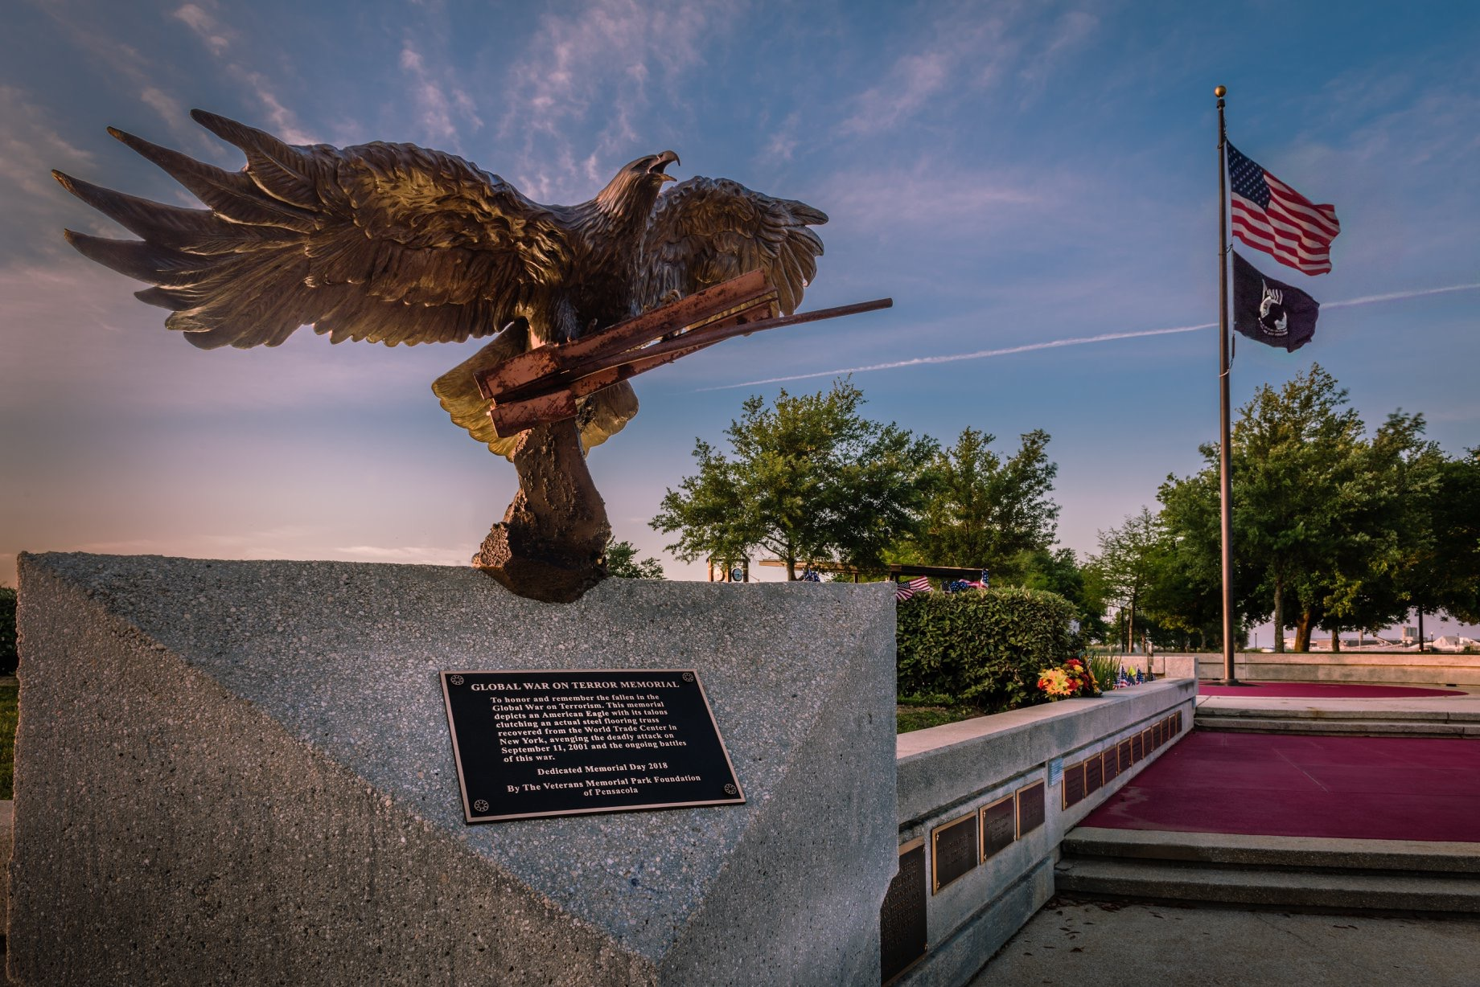
Nine Eleven Memorial

Slide 30
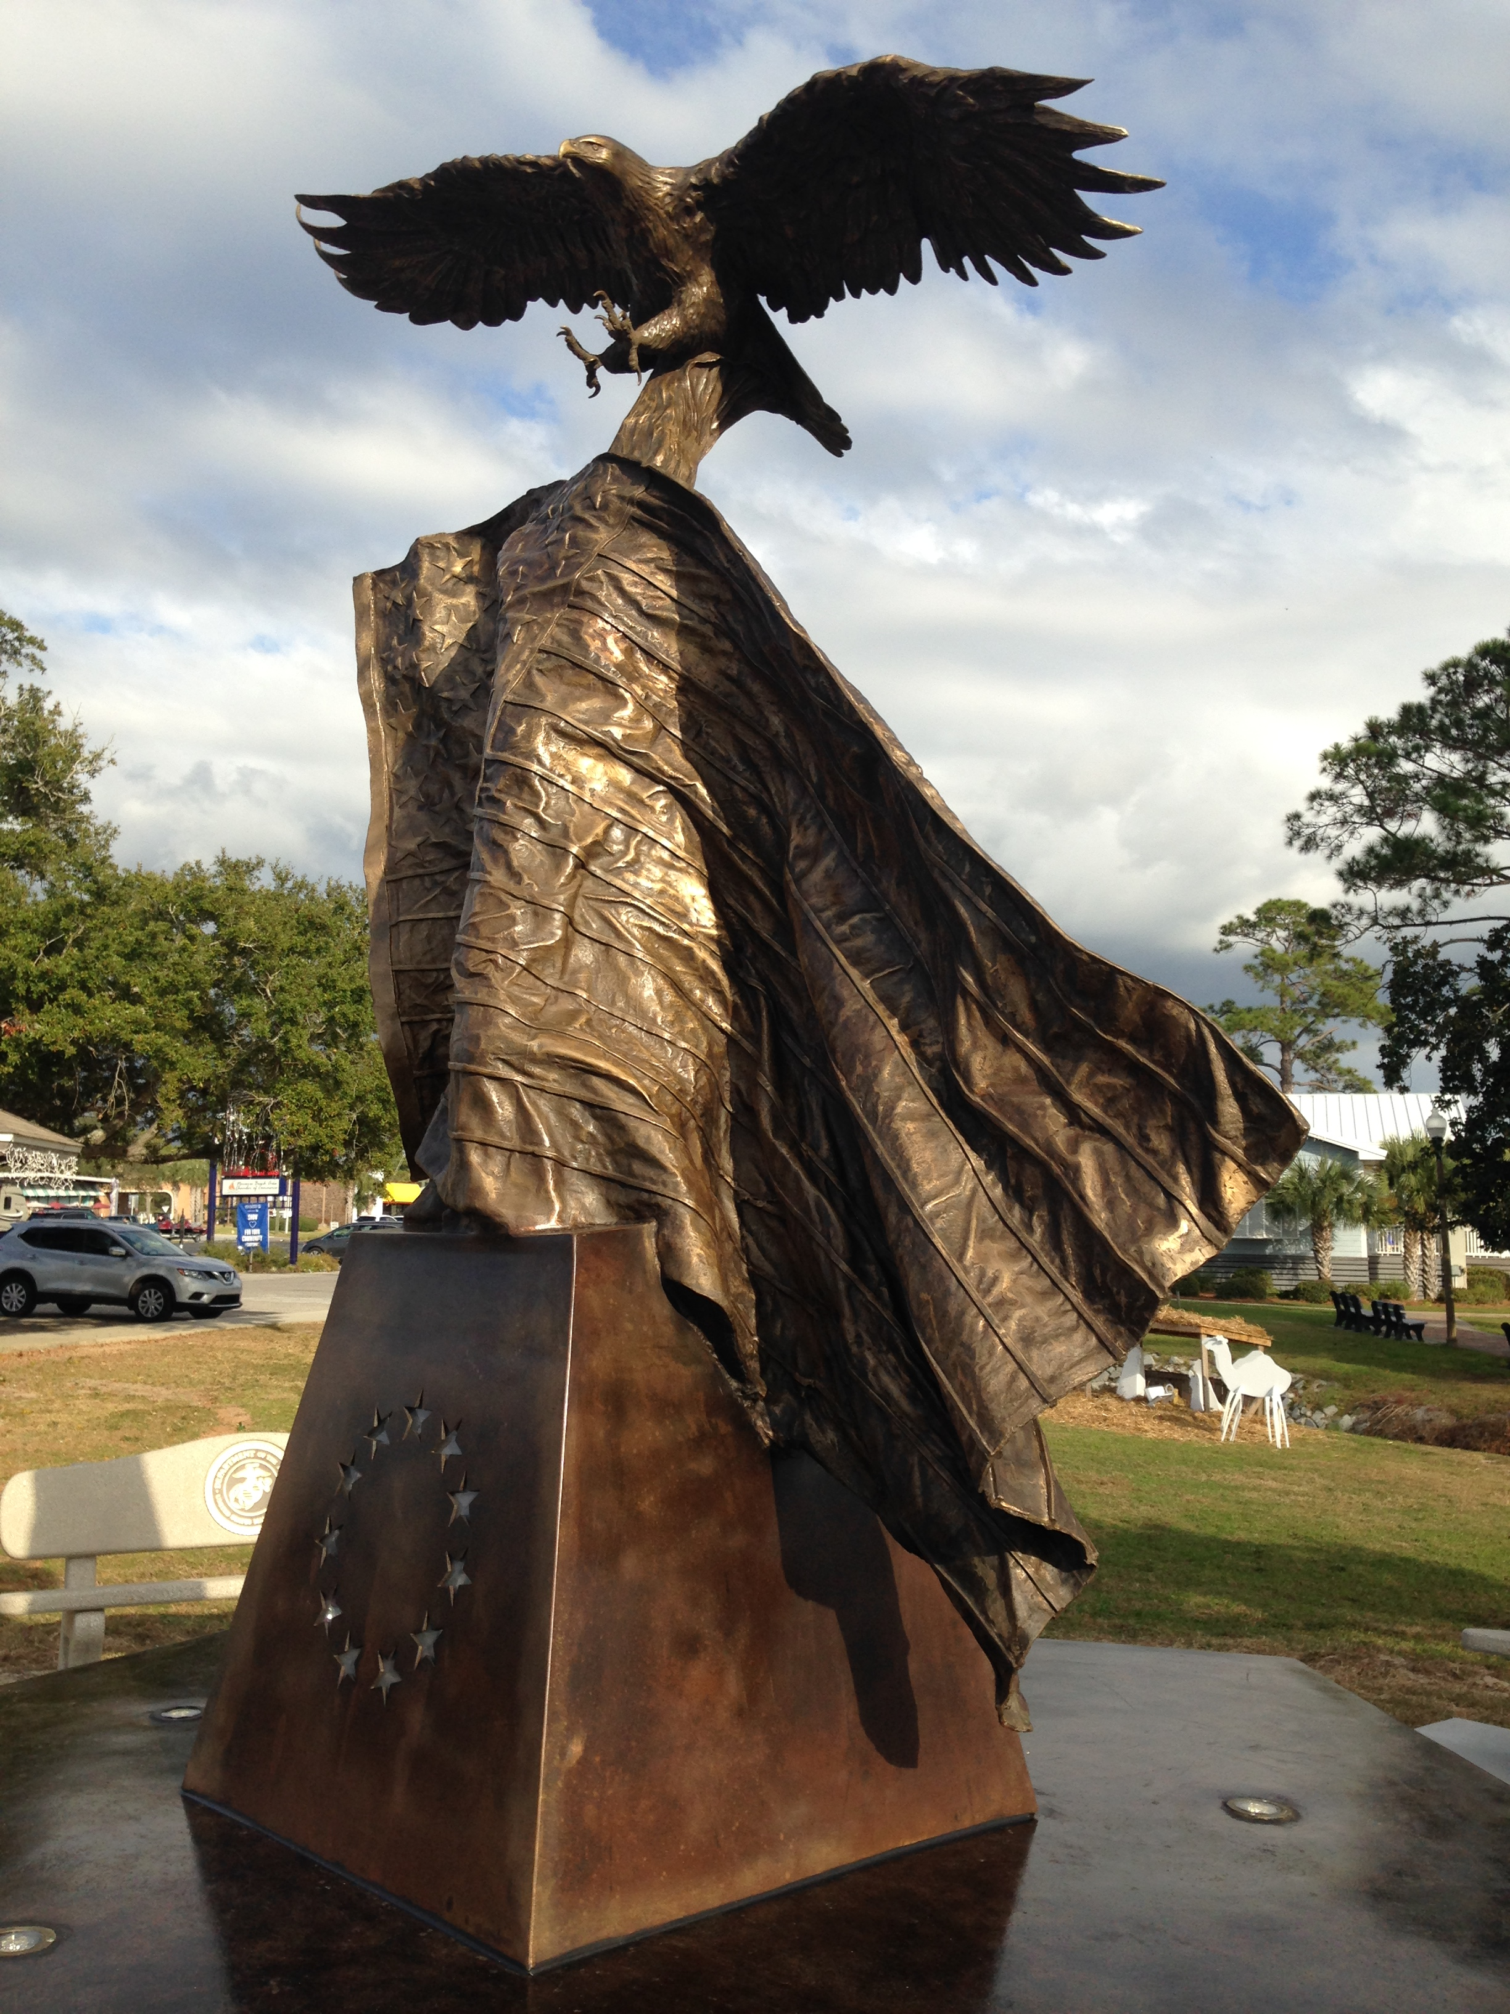
Navarre Blackhawk Memorial

Slide 31
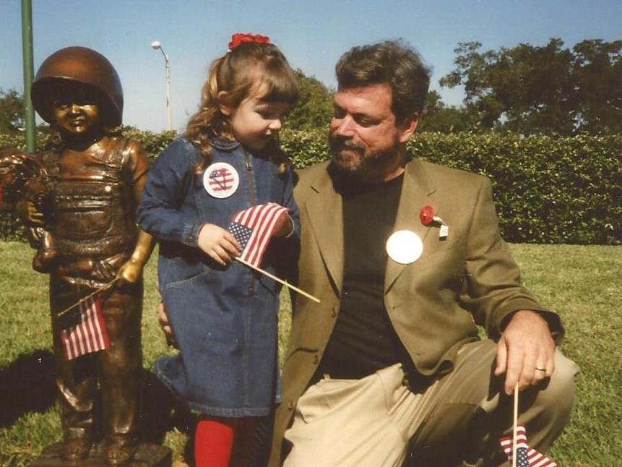
Children’s Memorial

